Slide 1
Fabulous = F# Functional FOR YOUR APP
Don Syme, Microsoft Researcher, F# Contributor
+ assistance from Mark Mallibone, Jim Bennett, Jason Imison, Miguel de Icaza, Phillip Carter, Fabulous Community Contributors

Slide 2
CAVEAT
This talk is informal, and not full of flashy demos
Notes:
Some good options existed but hadn’t quite taken hold. “winforms designer! WPF designer! Xaml designer on Mac! webforms designer! Xcode designer! Class designer! class browser!”. Some semi-functional architectures too (WebSharper UI.Next, Gjallahorn, others). ReactNative and other options are perceived as being functional-friendly. Can we make Xamarin friendly for F# developers?

Slide 3
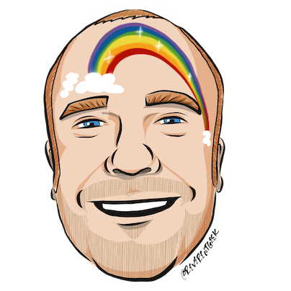







thanks
Timothé Larivière
co-maintainer on Fabulous, author of ElmishContacts and ElmishPlanets demos
Jim Bennett
Great talks on Fabulous!
Mark Mallibone
Swiss MVP , @mallibone
Frank Krueger
ImmutableUI was inspiration and initial partial list of Xamarin.Core bindings
Boris D. (github @dboris)
authored “Elmish.Forms” (“half-elmish” for static views only)
Jason Imison
F# in Visual Studio for Mac and Xamarin
Eugene Tolmachev
Creator or “Elmish” for Fable, used for WPF and others
Justin Sacks and others
Creators of “Elmish.WPF” (“half-elmish” for static views only)
Alfonso, Maxime, Steffen and many others
The Fable gang

Slide 4


Slide 5
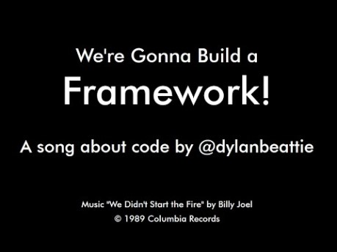

Slide 6
First, a little about F#

Slide 7
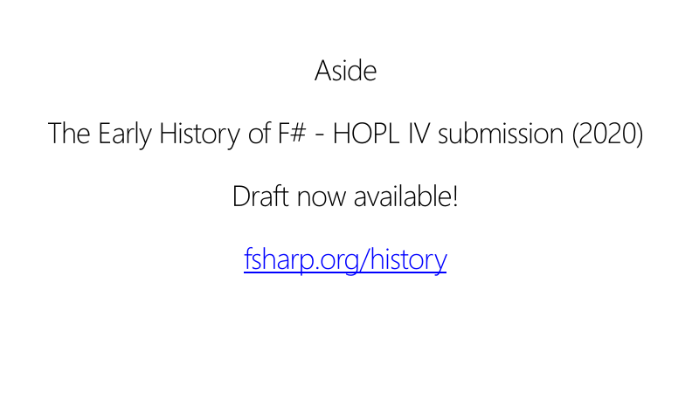

Slide 8
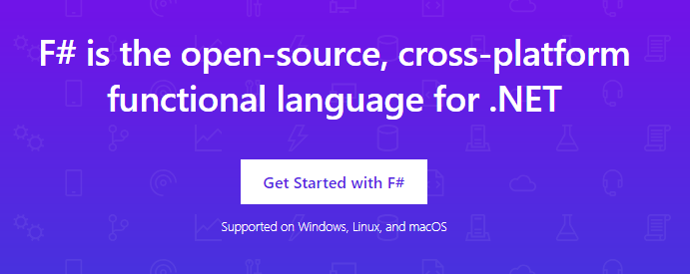
www.microsoft.com/net/

Slide 9
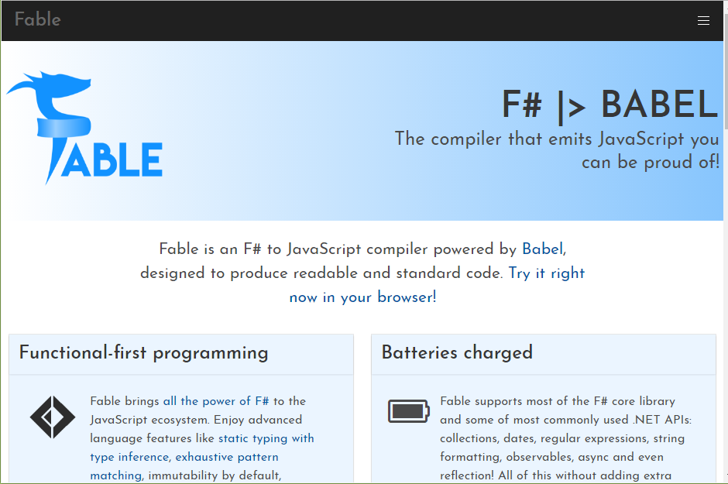

Slide 10
TL;DR – Where we are now
F# is open, cross-platform, neutral, independent
The F# Compiler Service powers many other tools
F# 4.6 now complete!
VSCode and .NET Core for Linux/OSX
All F# language and tooling is accepting contributions
Fable for F#-to-Javascript
SAFE for F# fullstack
The F# community is self-empowered
fsharp.org
VSCode, Visual Studio for Windows, Mac and Azure
Xamarin provide F# tools Android and iOS

Slide 11
The F# Language Design Process github.com/fsharp/fslang-design github.com/fsharp/fslang-suggestions

Slide 12
F# 4.0 ✔ True shift to cross-platform open engineering ✔ Long laundry list of language items ✔ Normalized core library ✔ Type providers more powerful ✔ Better debugging, tooling, performance ✔ ~20% compiler perf improvement
https://github.com/fsharp/fslang-design/tree/master/FSharp-4.0

Slide 13
F# 4.1 ✔ Optional large scope cycles more on this later) ✔ Result<T,Error> in standard library ✔ Unboxed (struct) tuples ✔ Unboxed (struct) records ✔ Unboxed (struct) unions ✔ More bits and pieces
https://github.com/fsharp/fslang-design/tree/master/FSharp-4.1

Slide 14
F# 4.5 ✔ Span<T> high perf type-safe non-allocating code ✔ Improved async debugging ✔ More bits and pieces
https://github.com/fsharp/fslang-design/tree/master/FSharp-4.5

Slide 15
F# 4.6 ✔ Anonymous records ✔ More bits and pieces
https://github.com/fsharp/fslang-design/tree/master/FSharp-4.5

Slide 16
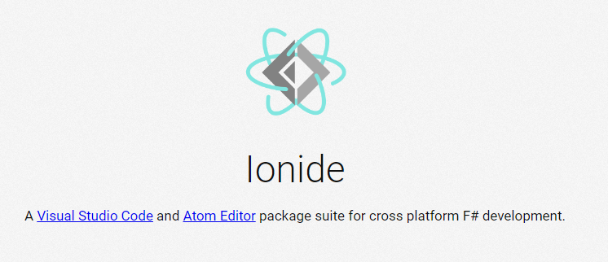
VSCode + Ionide = Cross-Platform F# Editing Love

Slide 17
F# and .NET Core (Linux, OSX, Windows) dotnet new -lang F# dotnet build docs.microsoft.com/dotnet/core/

Slide 19
The context
Initially F# embraced functional-first programming but lacked opinion on functional-first app development
Fable solves this for Web
But F# devs also need to be able to make Mobile and Desktop Apps
Notes:
Some good options existed but hadn’t quite taken hold. “winforms designer! WPF designer! Xaml designer on Mac! webforms designer! Xcode designer! Class designer! class browser!”. Some semi-functional architectures too (WebSharper UI.Next, Gjallahorn, others). ReactNative and other options are perceived as being functional-friendly. Can we make Xamarin friendly for F# developers?

Slide 20

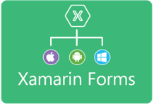












Situation: The world of UI is developing
OO programming
Complex mutable models
Declarative static UI
View in 2nd markup language
Complex designer tooling
Functional programming
Simple declarative models
Declarative dynamic UI
View in same language DSL
Simple live coding tooling
MVU
(model-view-update)
MVVM
(model-view-viewmodel)

Slide 21
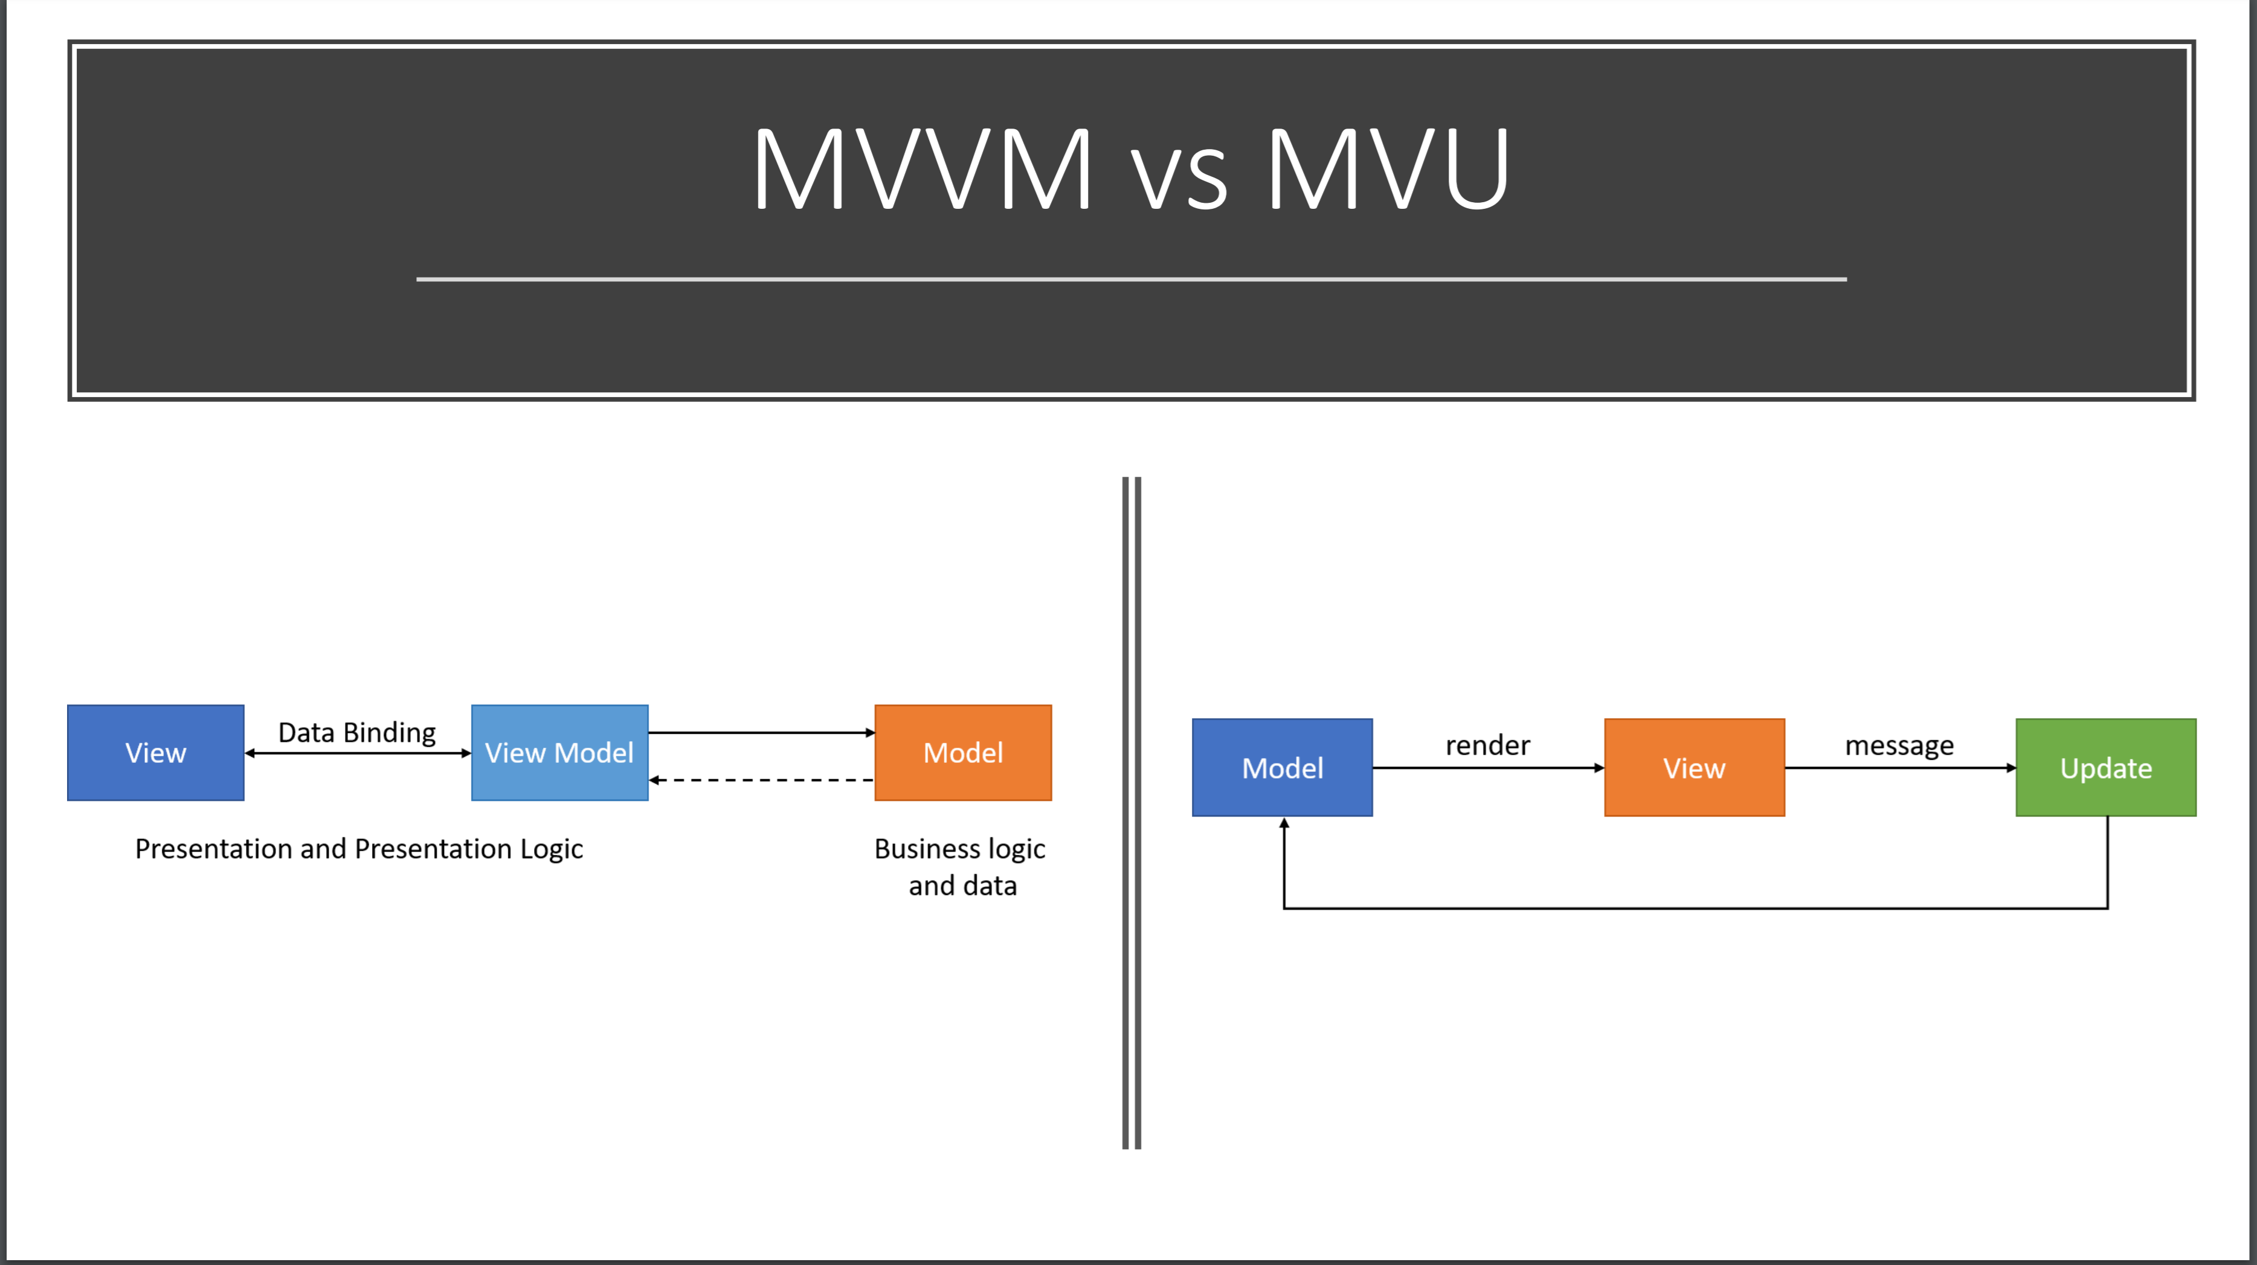

Slide 22
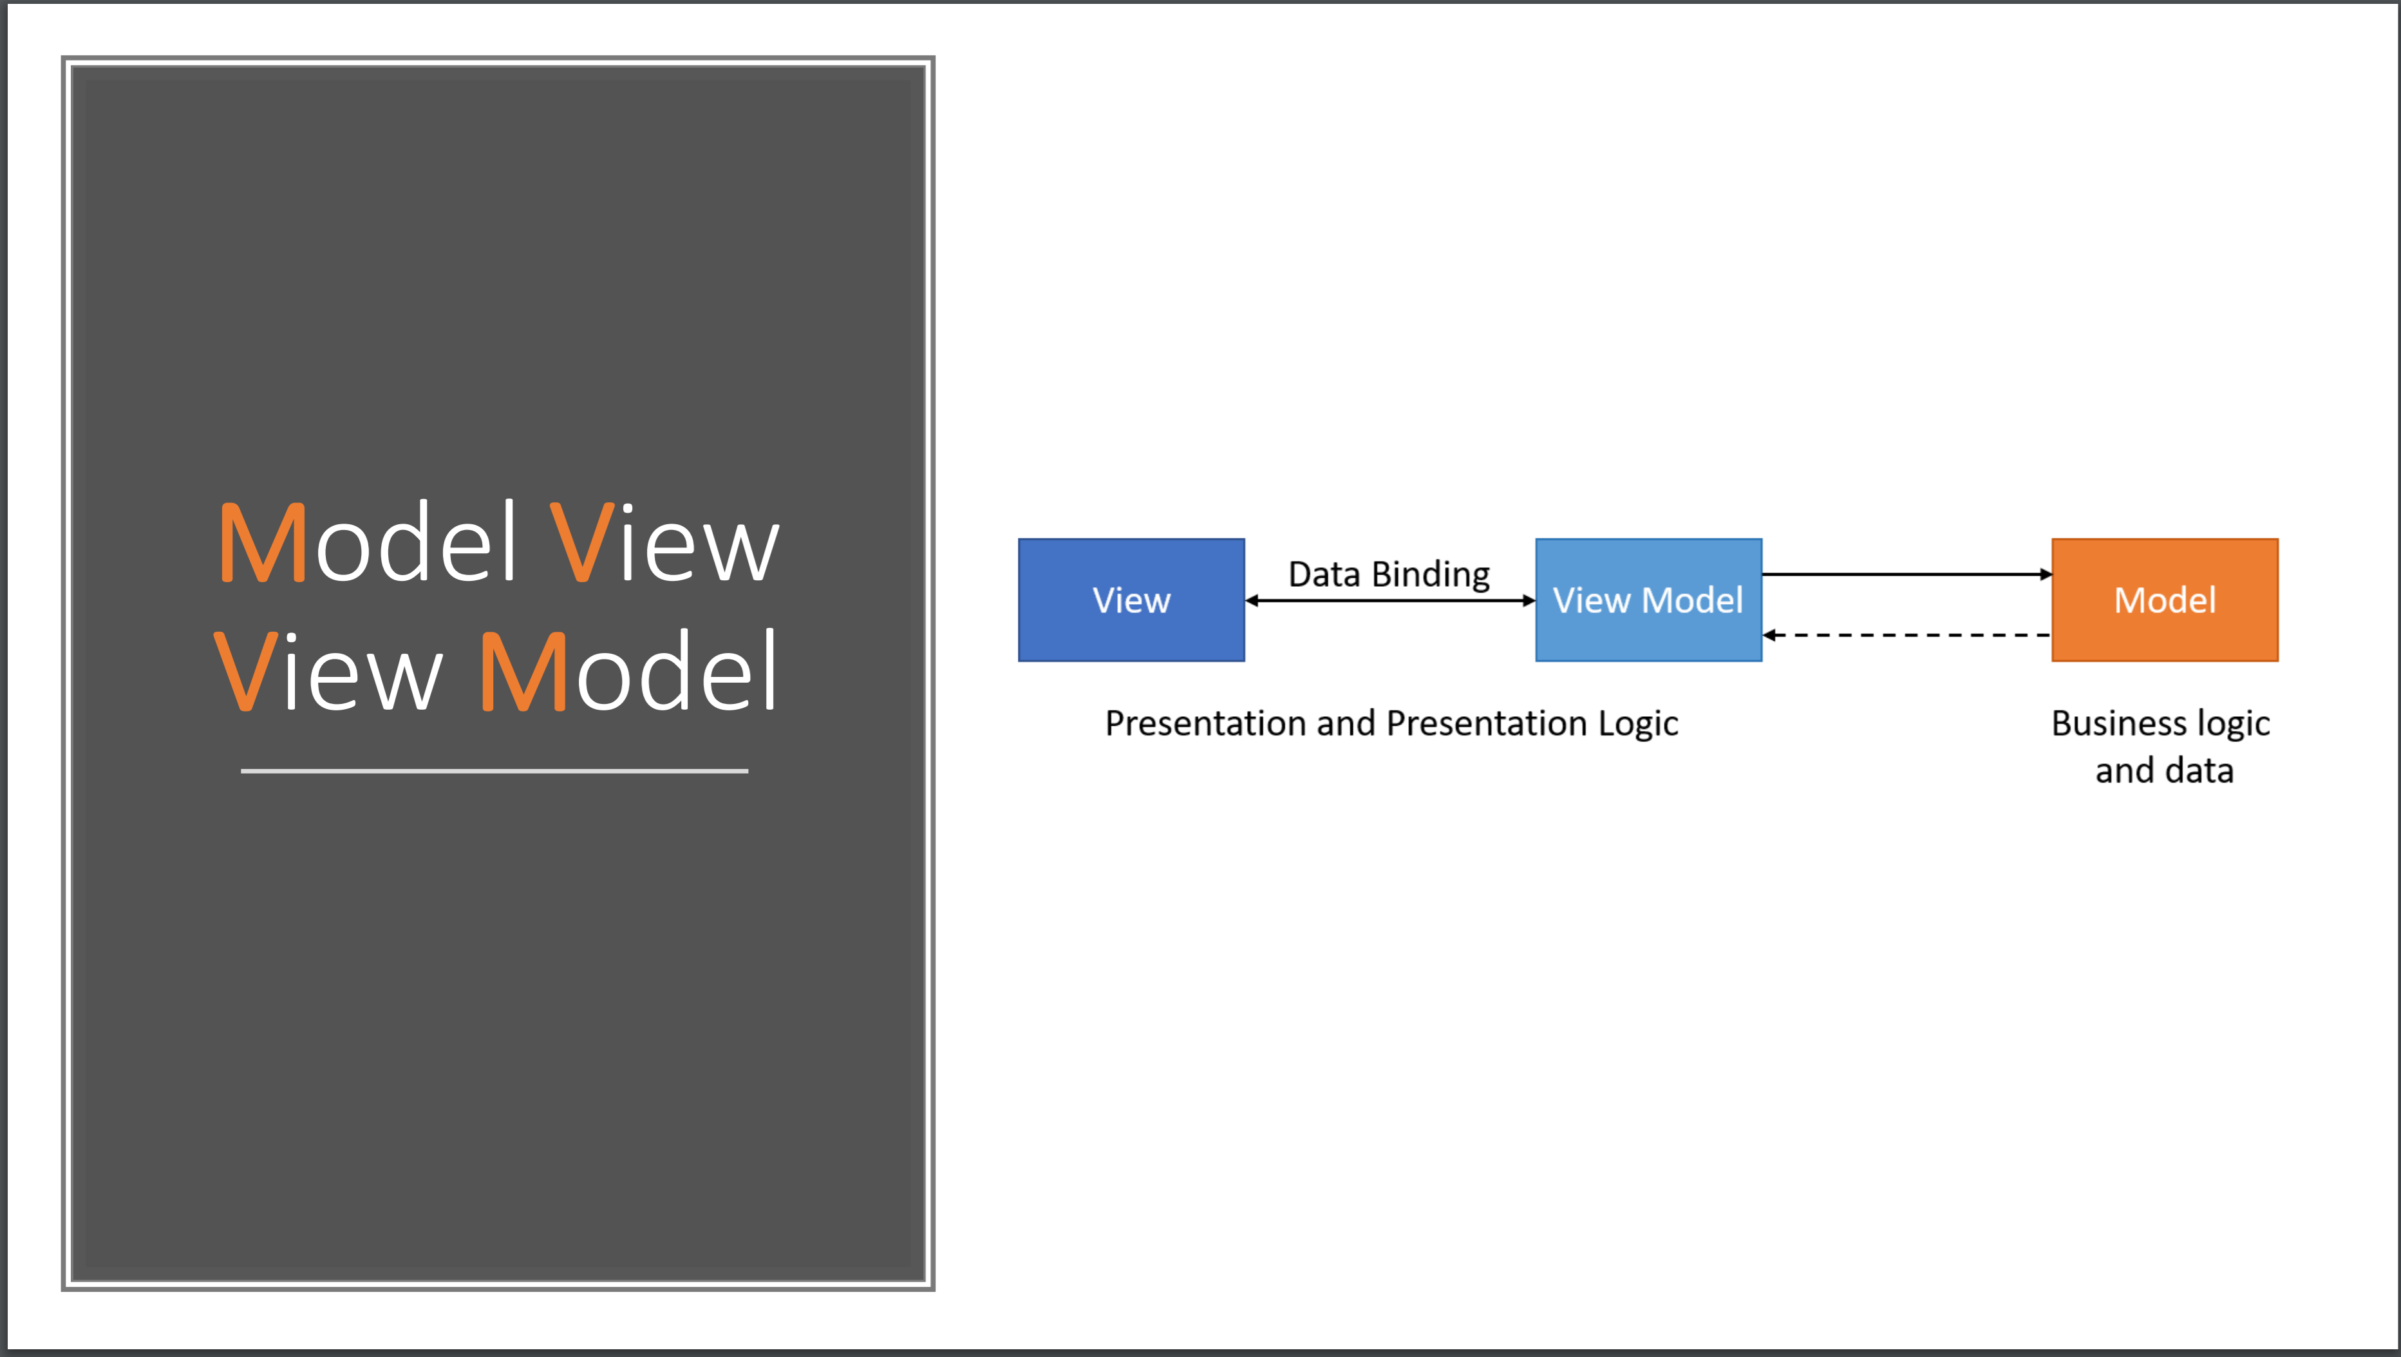

Slide 23
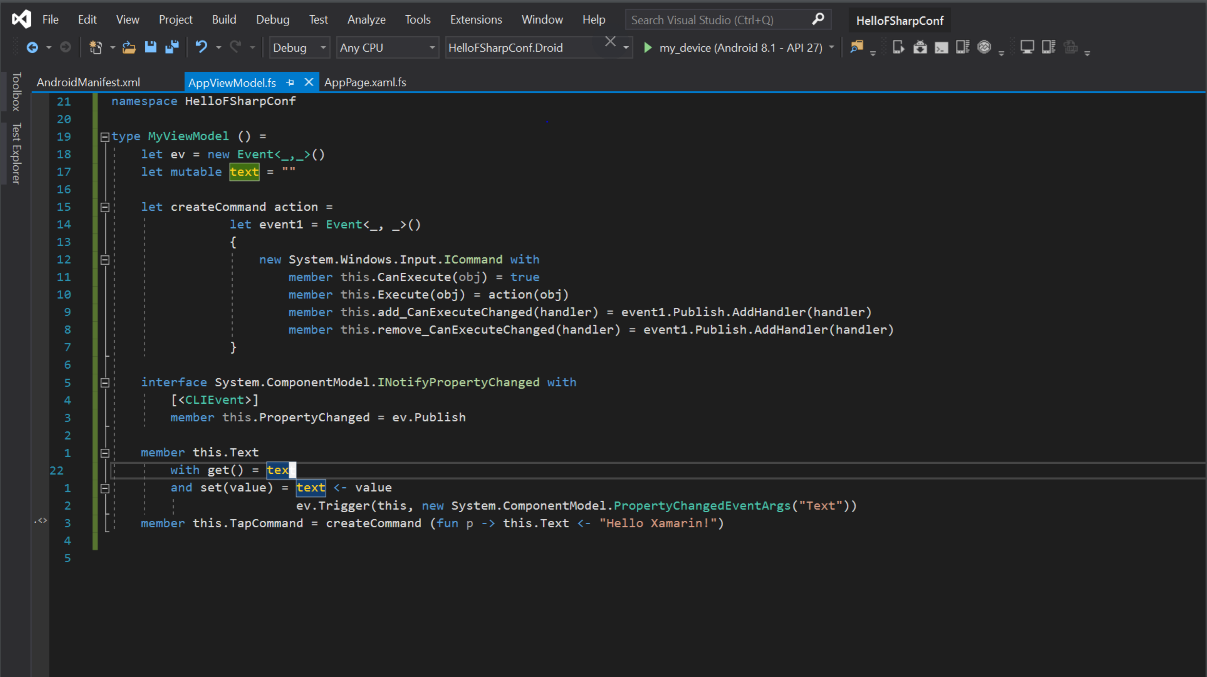

Slide 24
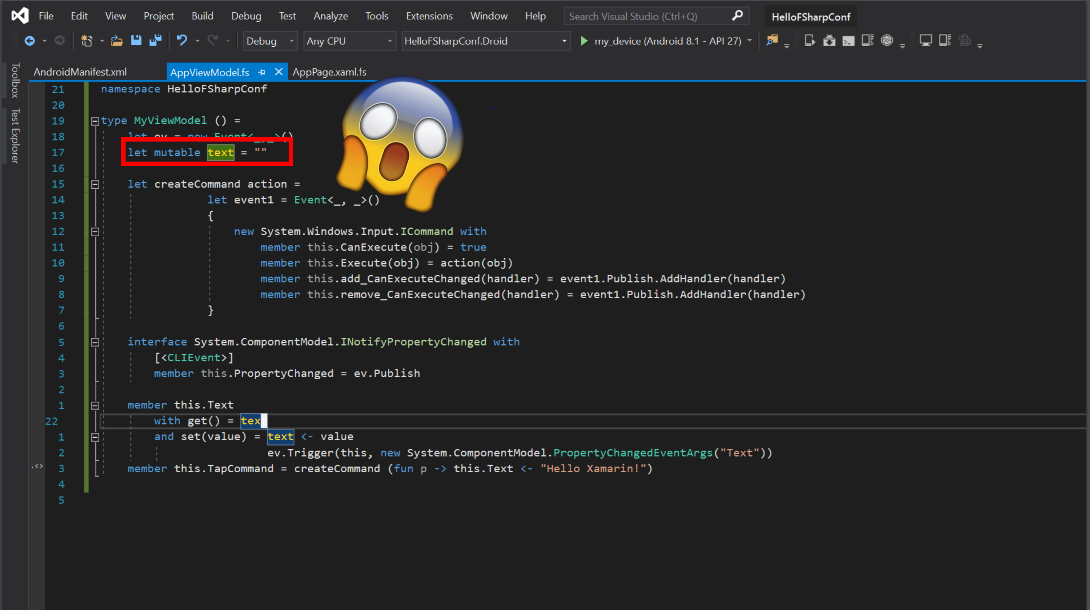

Slide 25
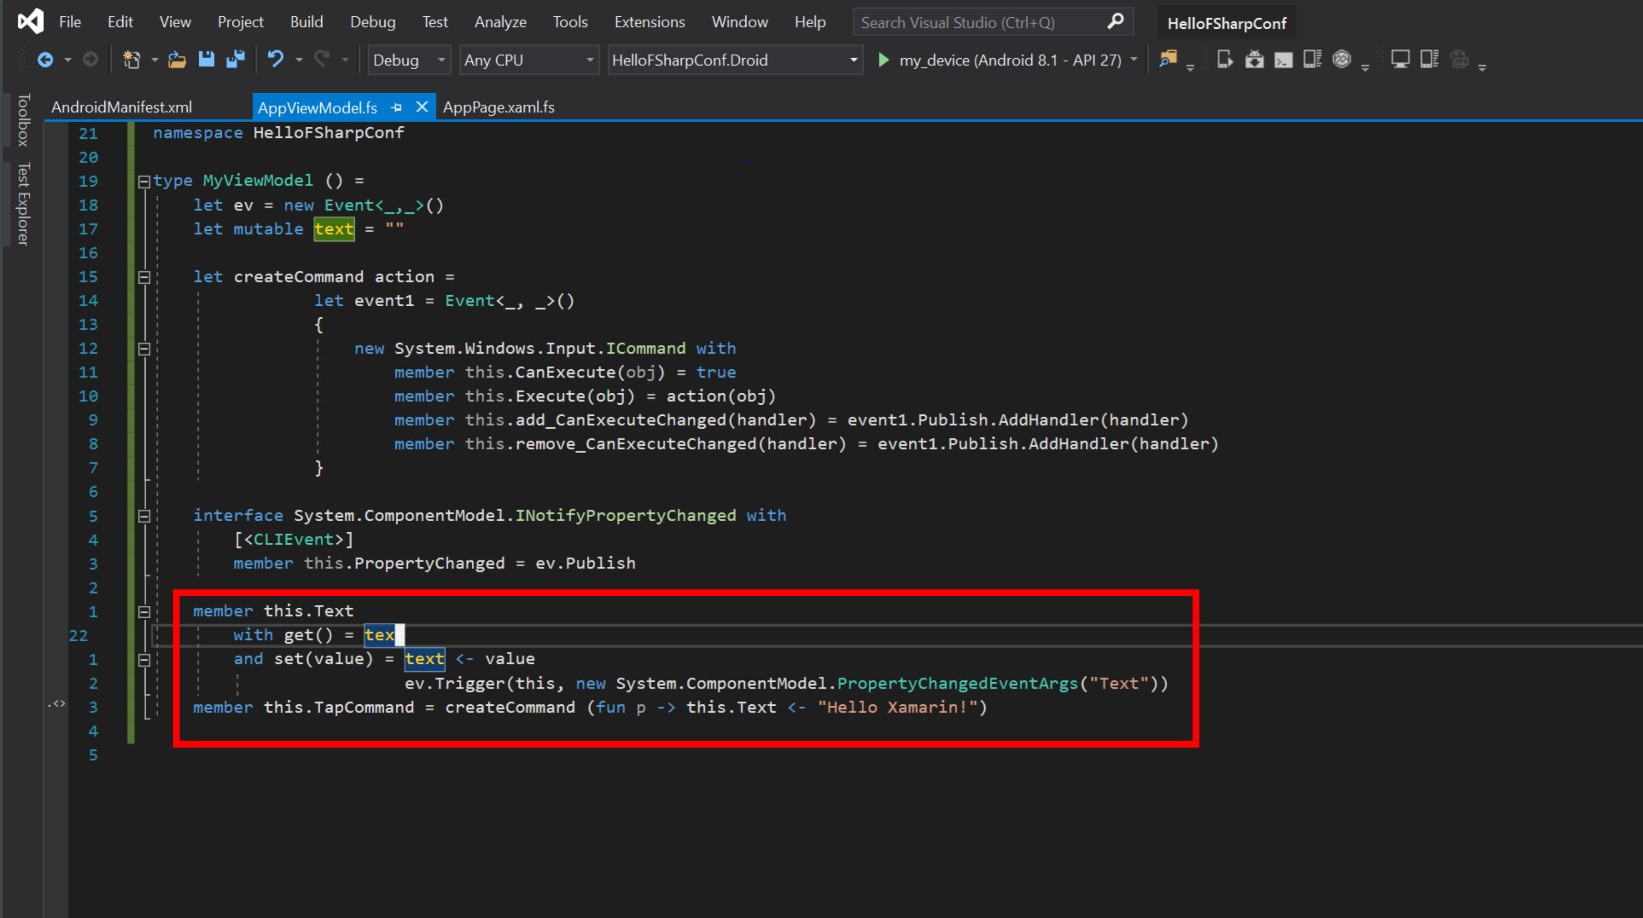

Slide 27
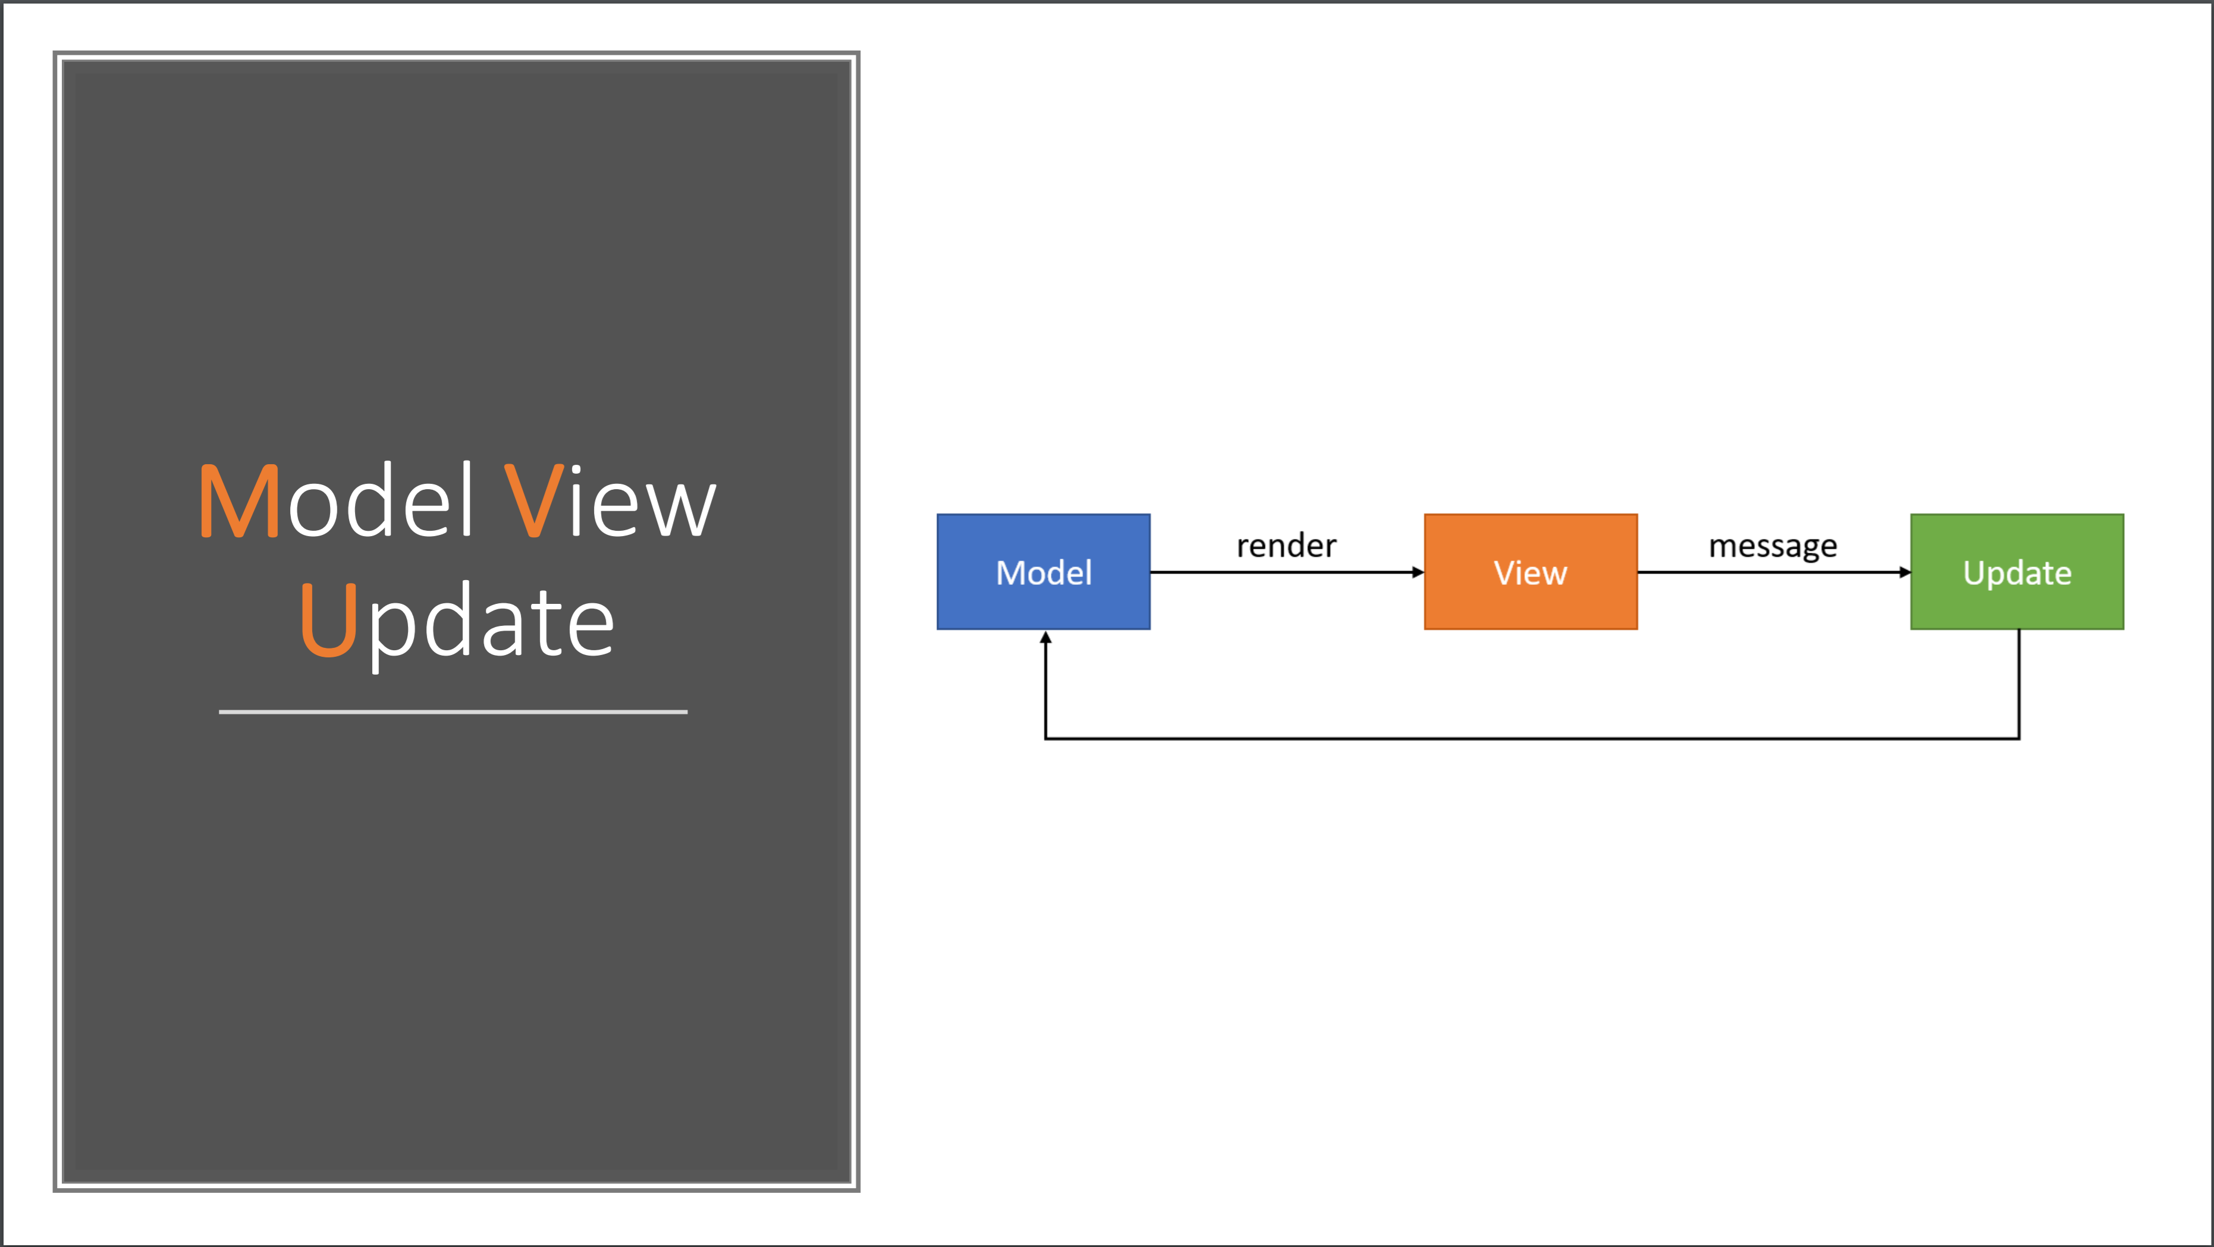

Slide 28
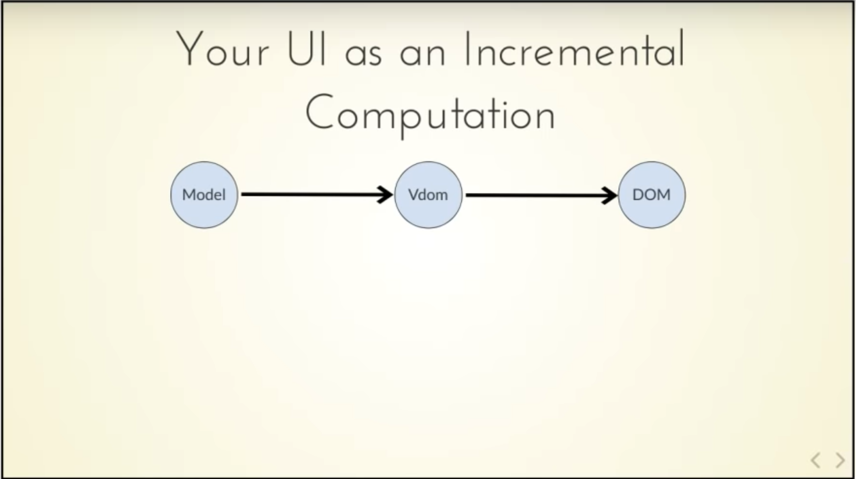
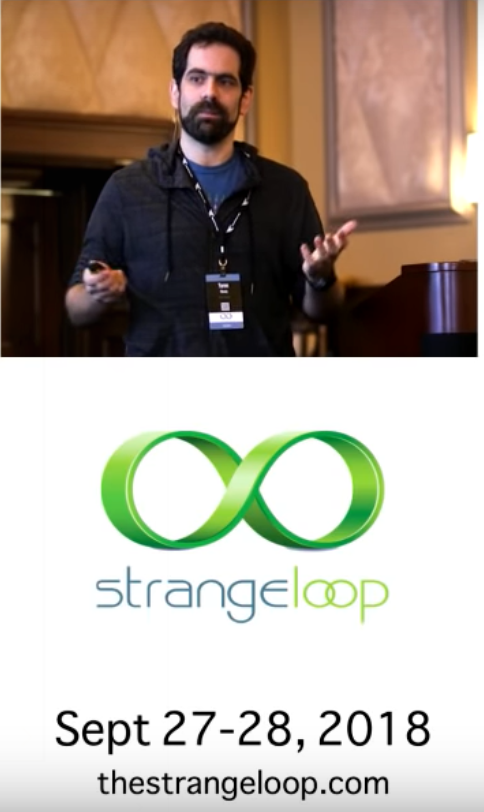

Slide 29
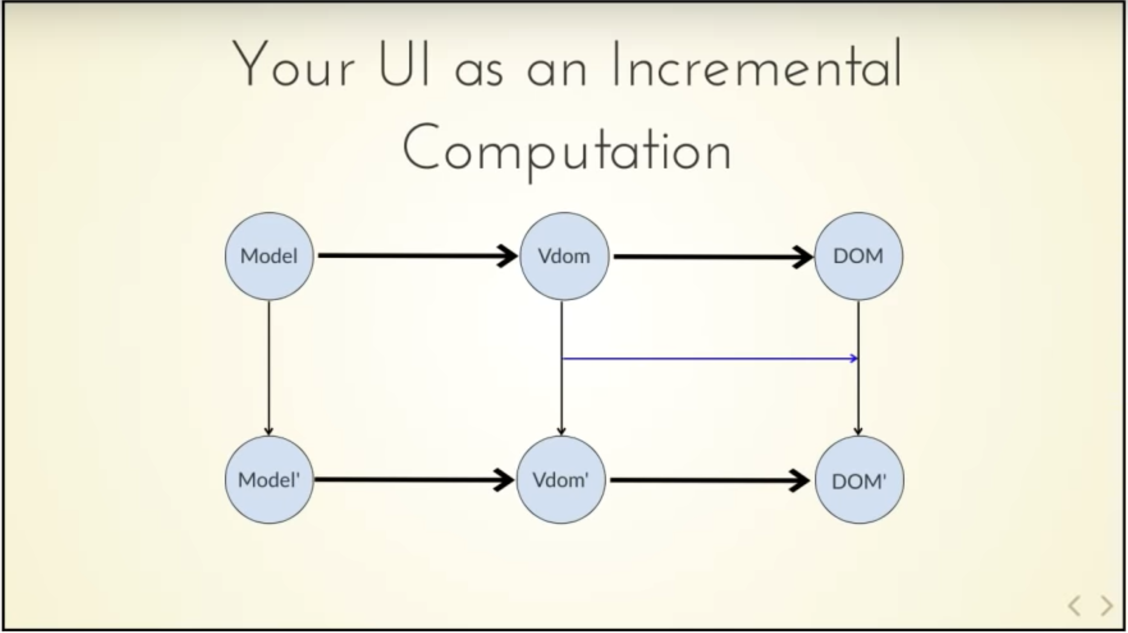
Δ

Slide 30
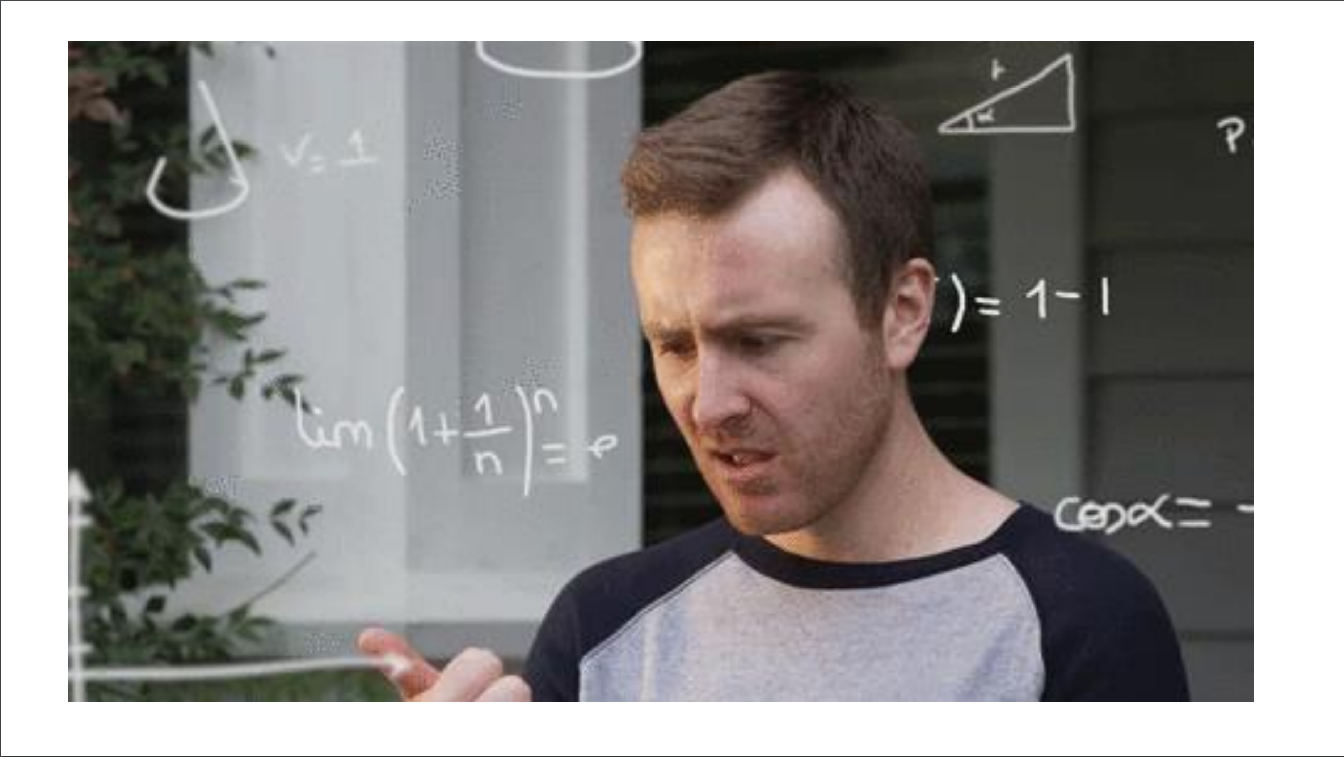

Slide 31
INSPIRATION
Fable has popularized the MVU architecture in F#
Fable+Elmish makes web app development simple
All F# code
View descriptions are separated but simple, and in F#
I’m very influenced by SAFE Stack
Non-F# people have found Fable+Elmish easy in business contexts
http://fable.io http://github.com/elmish
https://safe-stack.github.io/

Slide 32
THE PROBLEM WITH XAML
A core problem: Xaml
Xaml assumes “designers” will “sliced off” UI from code into a separate DSL.
Xaml is static, with layers of complexity (e.g. templating), and code-like constructs (behaviours, convertors), and requires complex designer tooling (which often fails).
Xaml stems from a fundamental category mistake in 2003 (“dynamic UI should be separated into a static markup language”)

Slide 33
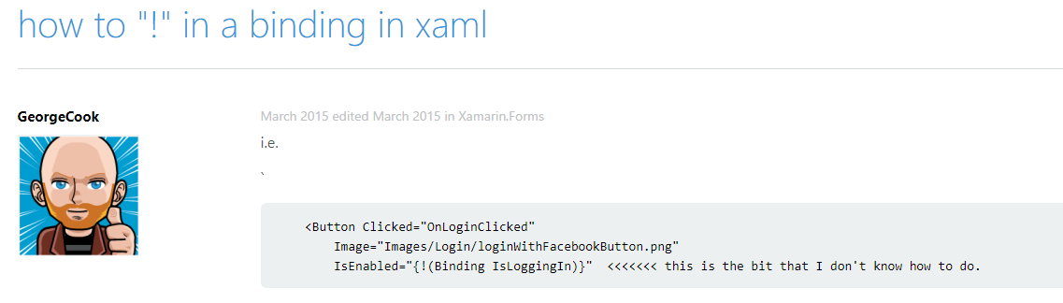
THE PROBLEM WITH XAML

Slide 34
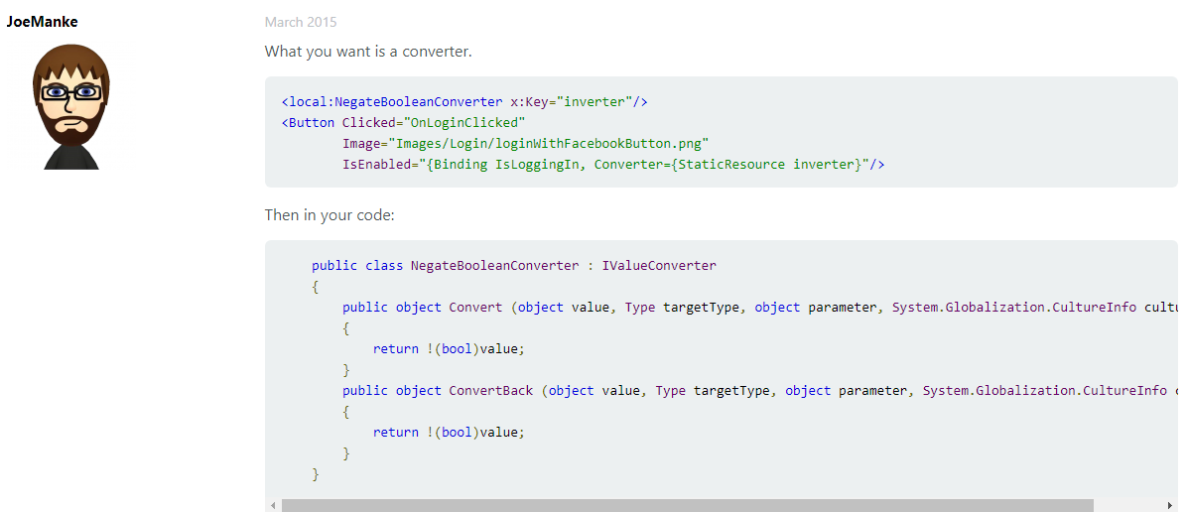
THE PROBLEM WITH XAML

Slide 35
The VIEW DSL
View looks like this:
let view (model: Model) dispatch =
View.ContentPage(content=
View.StackLayout(padding=30.0,verticalOptions = LayoutOptions.Center, children=[
View.Label(text= string model.Count, horizontalOptions=LayoutOptions.Center)
View.Button(text="Increment", command= (fun () -> dispatch Increment))
View.Button(text="Decrement", command= (fun () -> dispatch Decrement))
View.Slider(minimum=0.0, maximum=10.0, value=model.Step,
valueChanged= (fun args -> dispatch (SetStep (int args.NewValue))))
View.Label(text=sprintf "Step size: %d" model.Step, horizontalOptions=LayoutOptions.Center)
View.Button(text="Reset", horizontalOptions=LayoutOptions.Center,
command=(fun () -> dispatch Reset), canExecute = model.Changed)
]))

Slide 36
The VIEW DSL
View looks like this:
let view (model: Model) dispatch =
View.ContentPage(content=
View.StackLayout(padding=30.0,verticalOptions = LayoutOptions.Center, children=[
View.Label(text= string model.Count, horizontalOptions=LayoutOptions.Center)
View.Button(text="Increment", command= (fun () -> dispatch Increment))
View.Button(text="Decrement", command= (fun () -> dispatch Decrement))
View.Slider(minimum=0.0, maximum=10.0, value=model.Step,
valueChanged= (fun args -> dispatch (SetStep (int args.NewValue))))
View.Label(text=sprintf "Step size: %d" model.Step, horizontalOptions=LayoutOptions.Center)
View.Button(text="Reset", horizontalOptions=LayoutOptions.Center,
command=(fun () -> dispatch Reset), canExecute = not model.Unchanged)
]))
How easy is that?

Slide 37
THE NEED
What’s needed?
the simplicity of MVU, but for Mobile and Desktop Apps

Slide 38
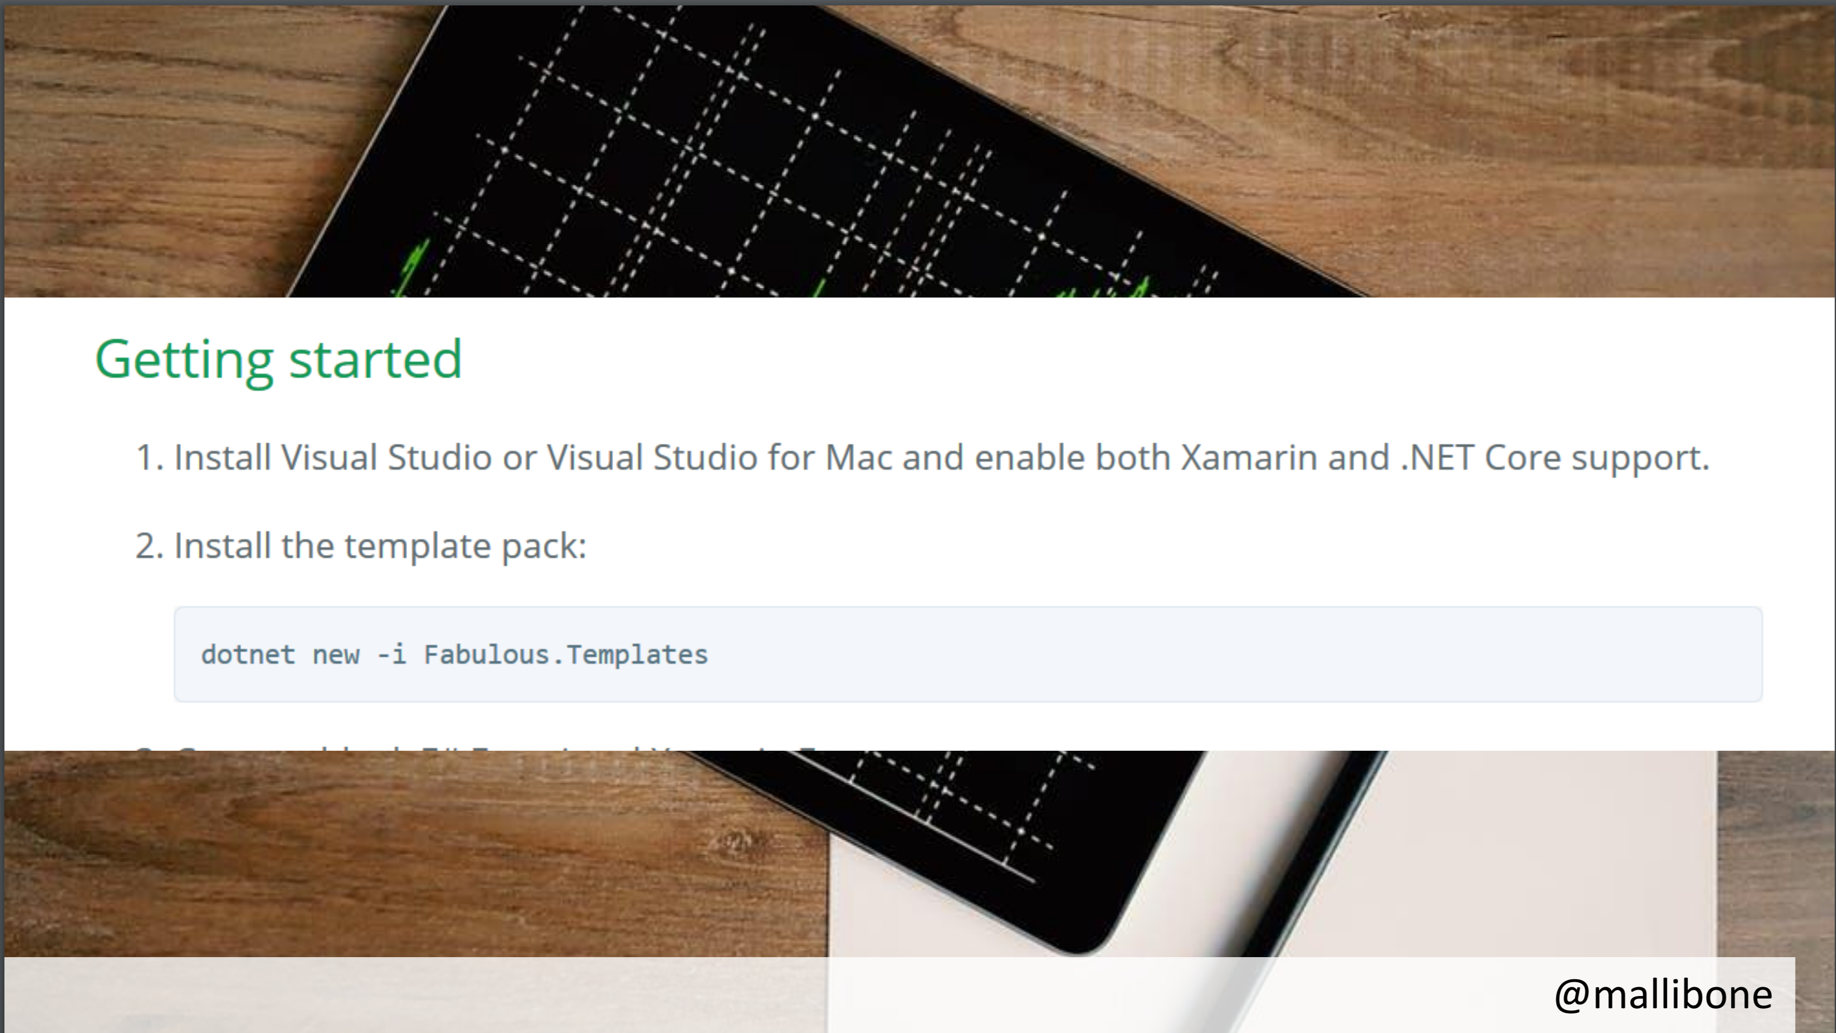

Slide 39
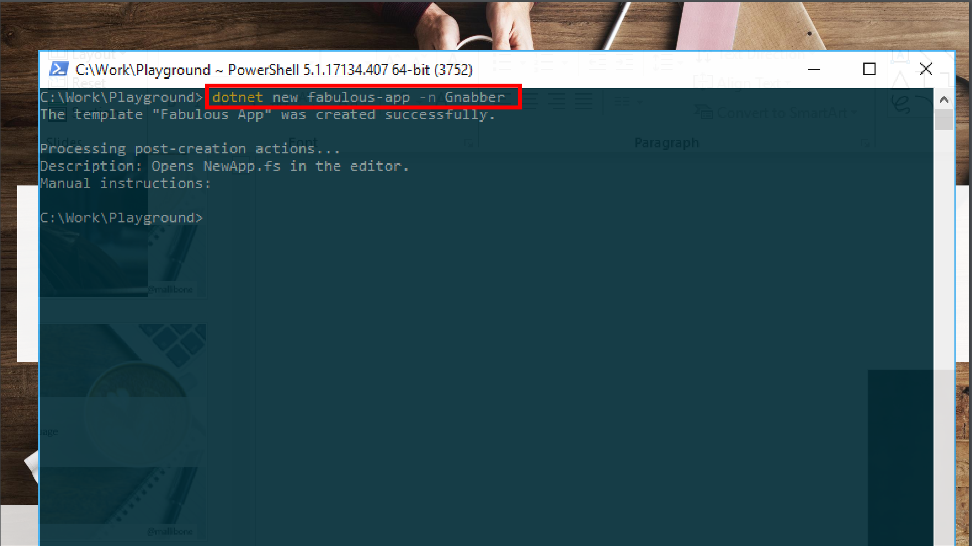

Slide 40


Slide 41
Demo I

Slide 42
A Simple MVU App
type Model =
{ … }
type Msg =
| …
| …
let init() =
{ … }
let update msg model =
match msg with
| … -> { model with … }
| … -> { model with … }
let view model dispatch =
if model.IsPressed then
… dispatch msg …
else
… dispatch msg …
The model from which
the view is generated
Messages which cause
updates to the model
Initial state
Update the model
Compute the view

Slide 43
A Simple MVU App
type Model =
{ IsPressed: bool }
type Msg =
| Pressed
let init() =
{ IsPressed=false }
let update (msg: Msg) (model: Model) =
match msg with
| Pressed -> { model with IsPressed = true }
let view (model: Model) dispatch =
if model.IsPressed then
View.Label(text="I was pressed!")
else
View.Button(text="Press Me!", command=(fun () -> dispatch Pressed))
The model from which
the view is generated
Messages which cause
updates to the model
Initial state
Update the model
Compute the view

Slide 44
MVU
It’s all just functional programming
UI becomes a information-flow problem
Views and model update are just functional programming
Views are re-computed
New view applied to underlying controls using differential update
If view hasn’t changed, no updates are made
Messages are explicit and easy to trace

Slide 45
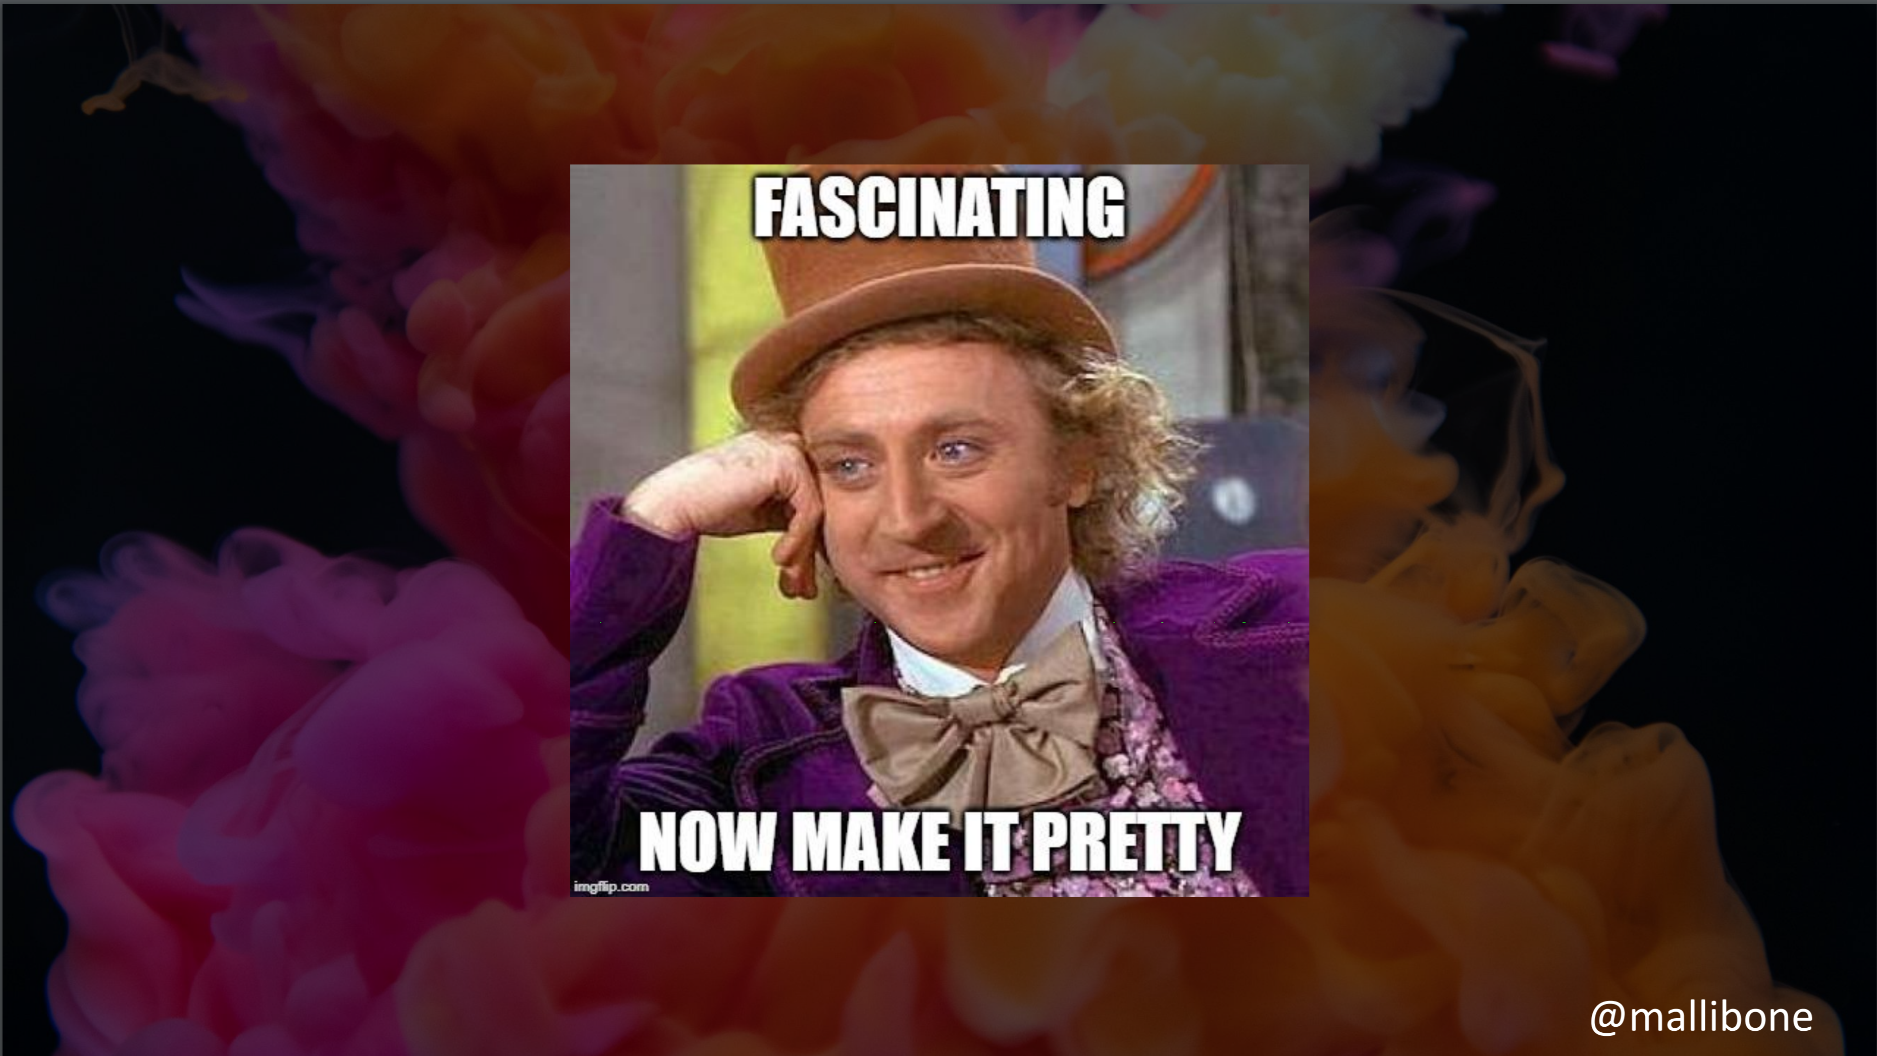

Slide 46
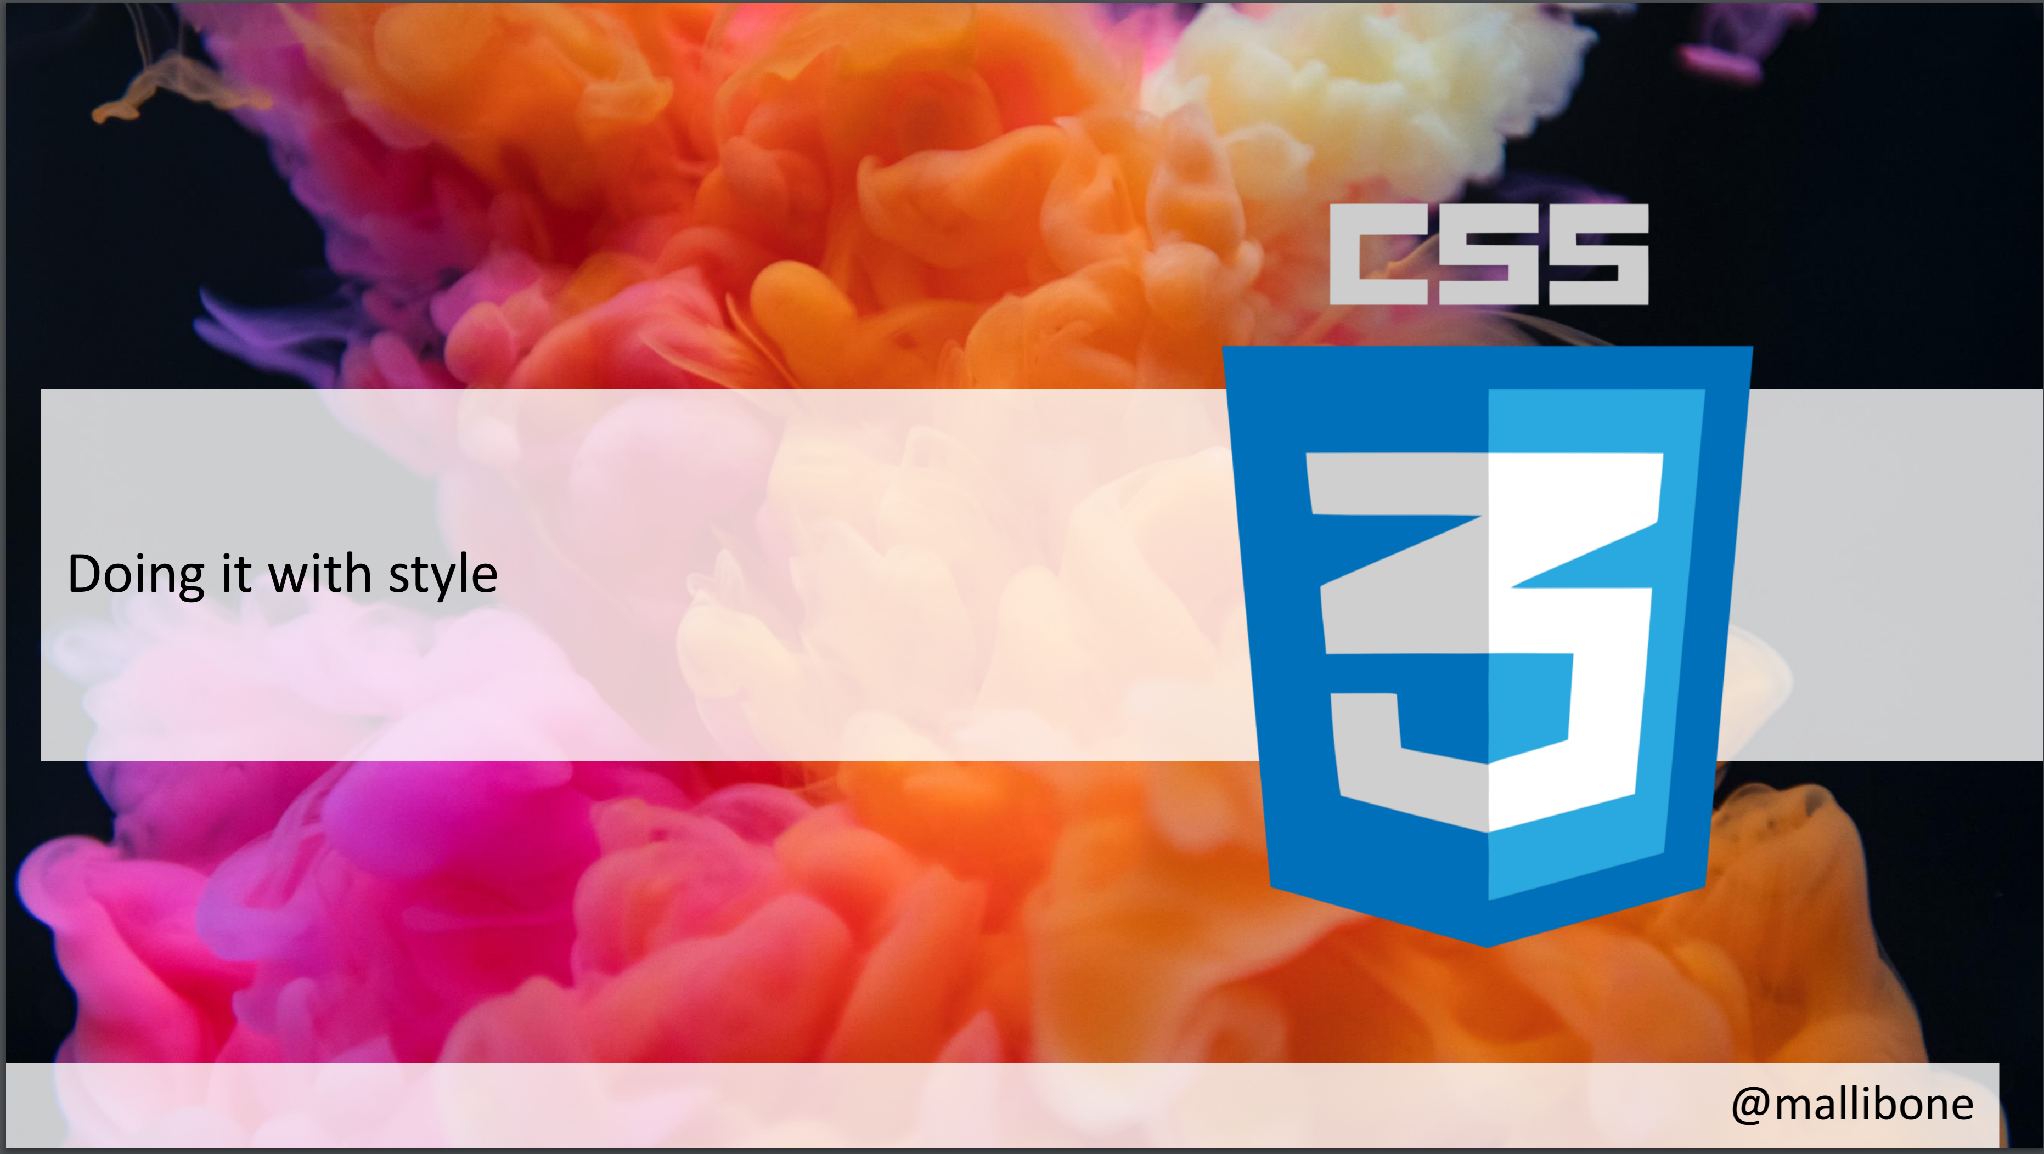

Slide 47
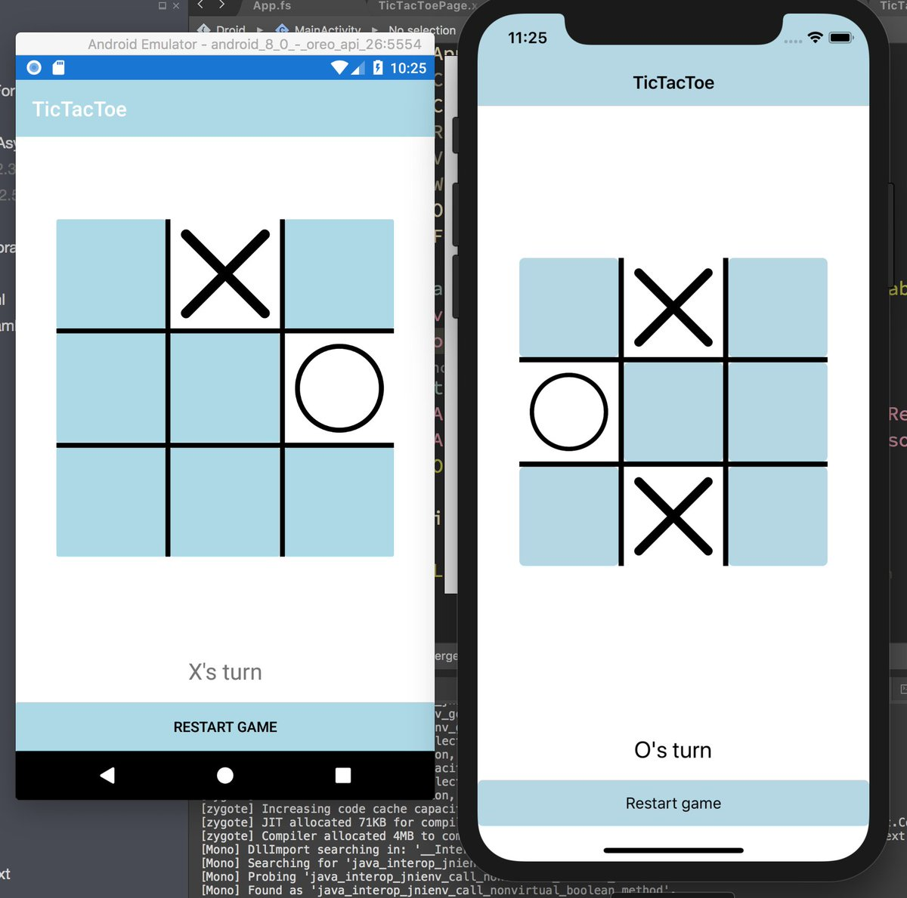
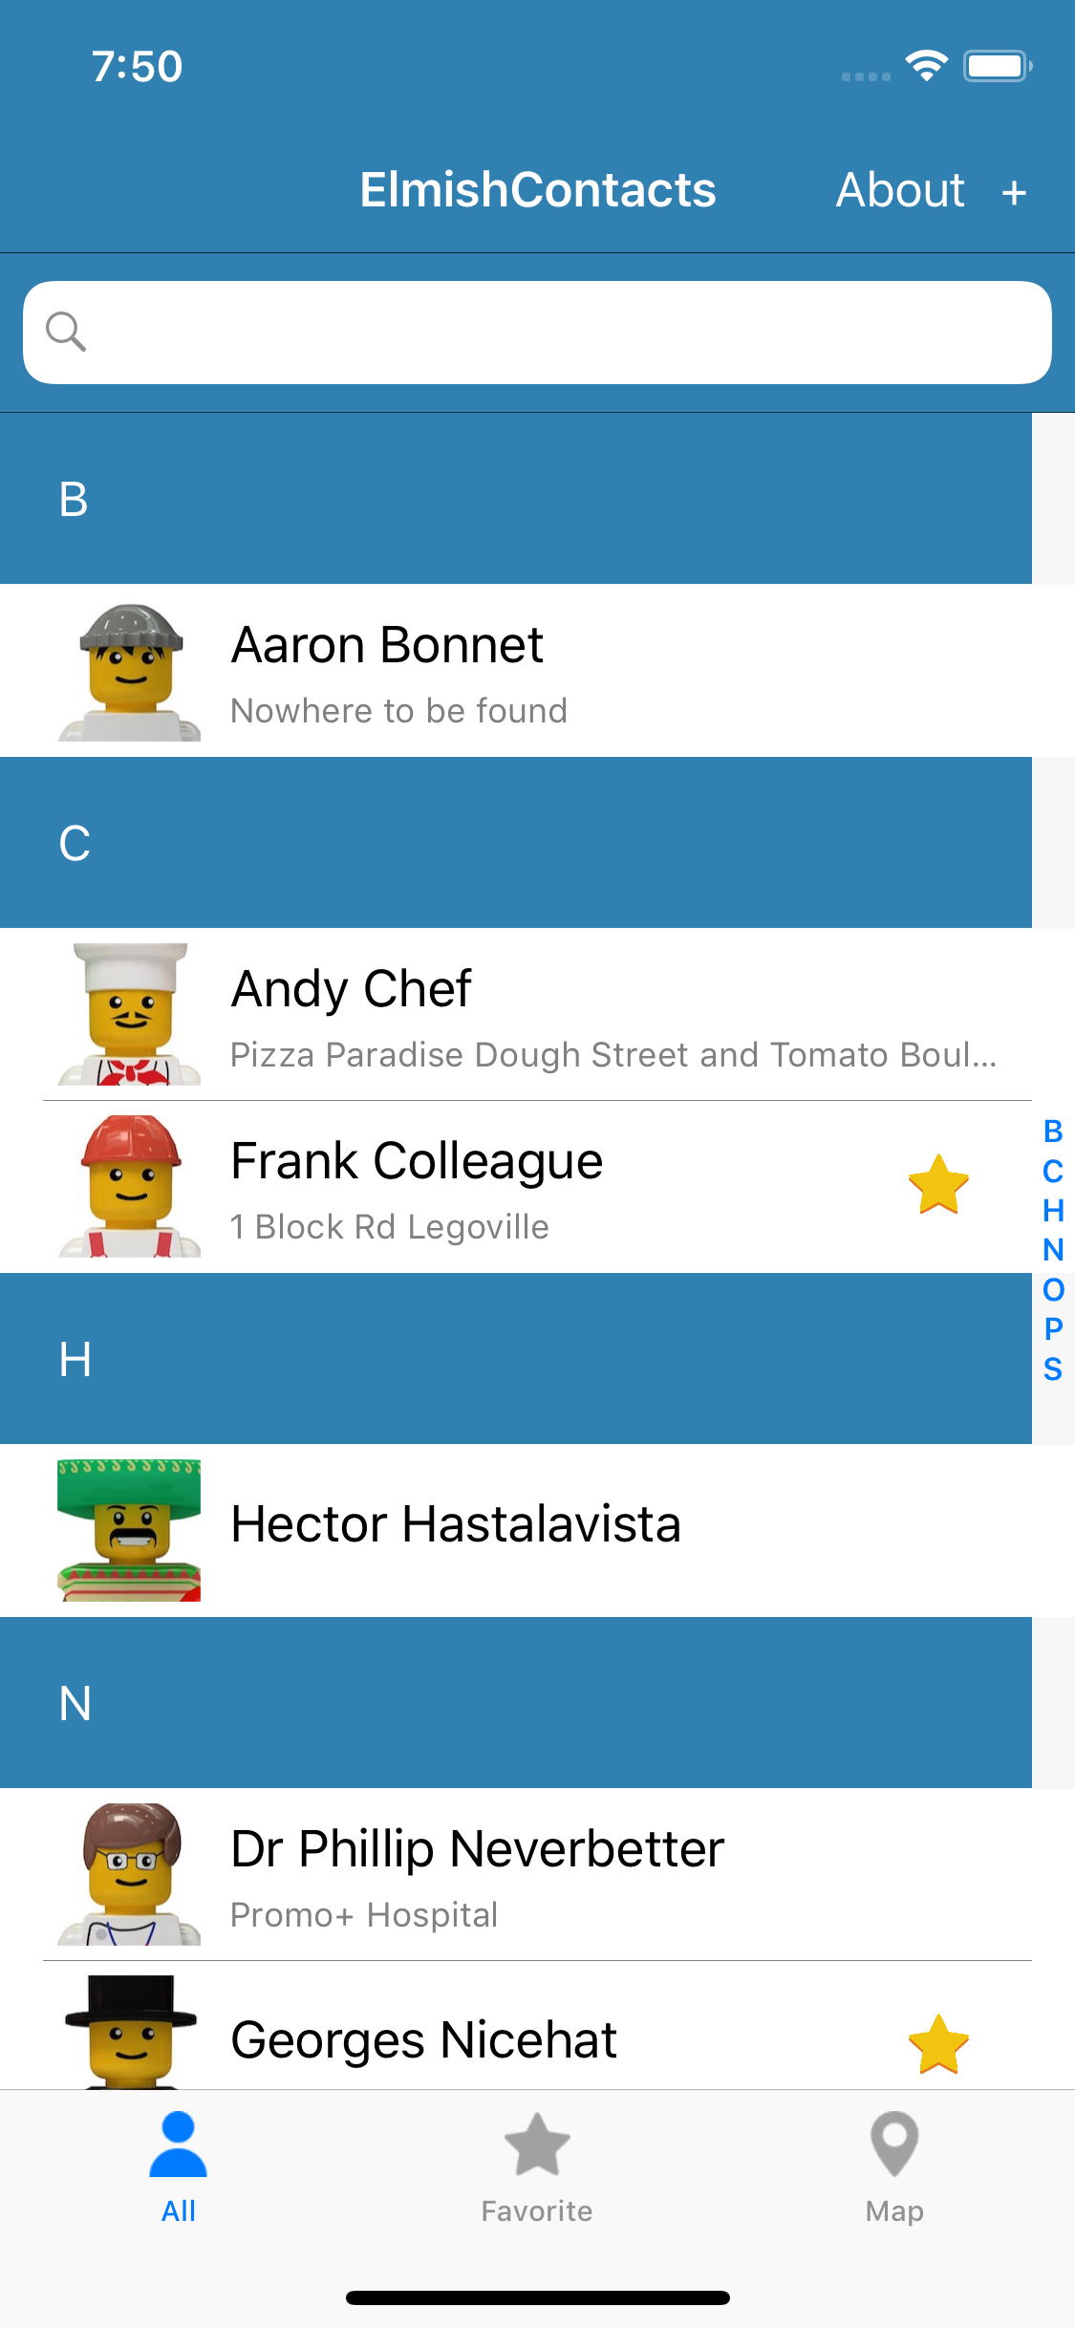
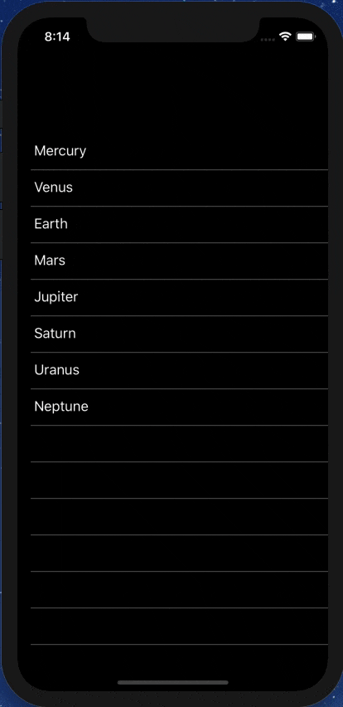
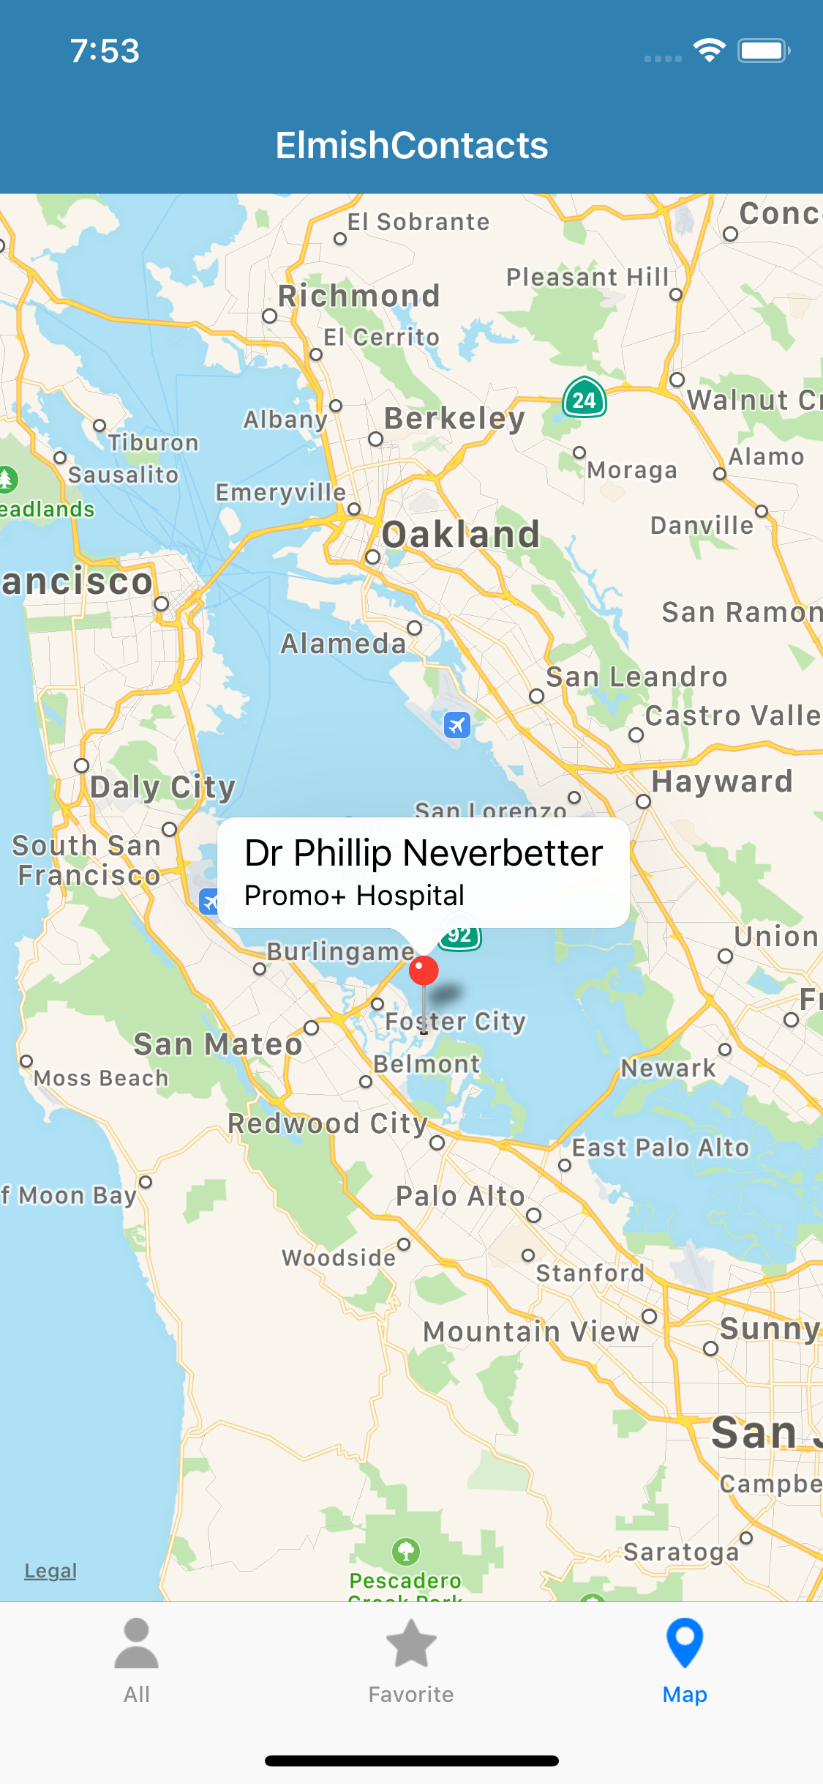
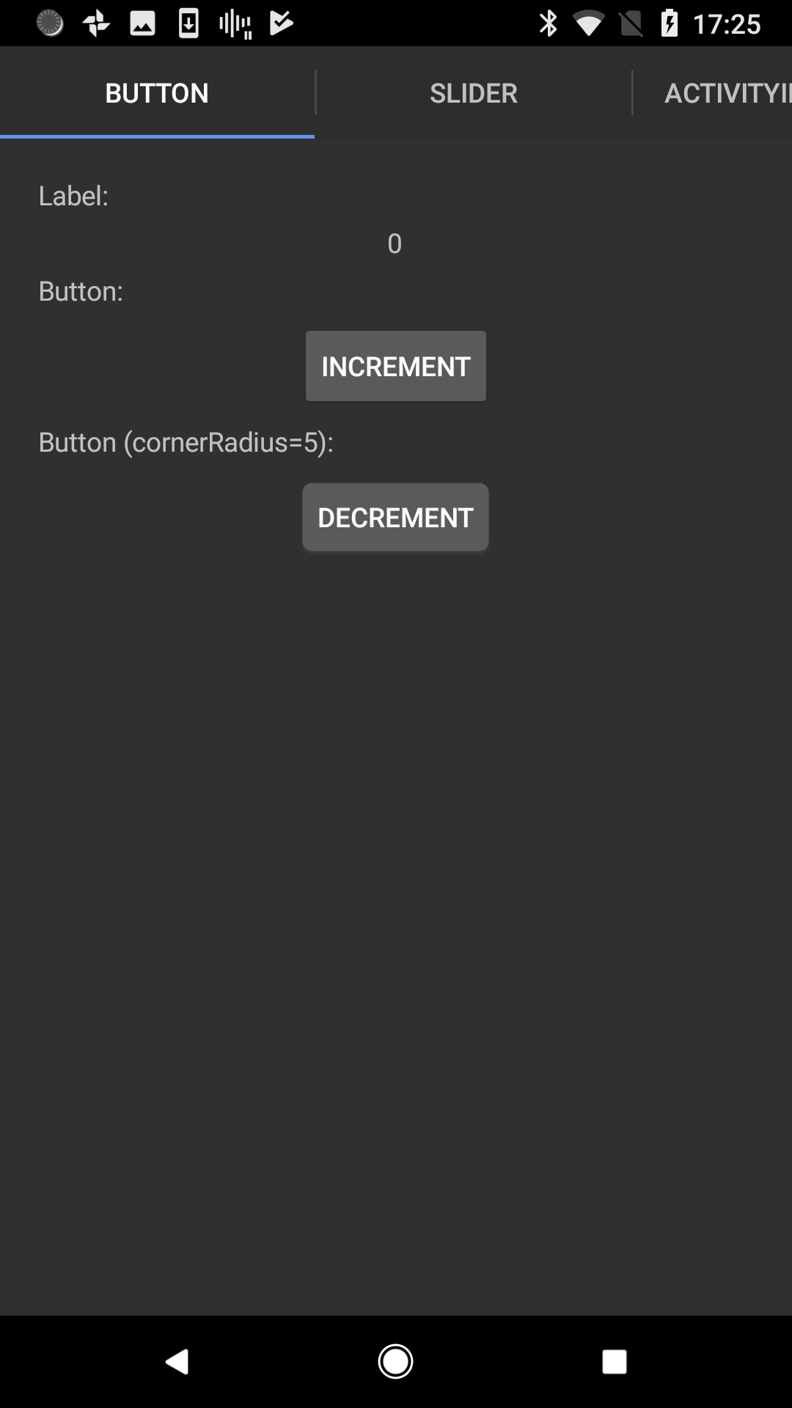

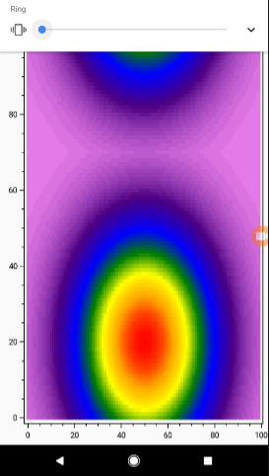


Slide 48
ELMISH CONTACTS

Slide 49
LEARN!
ElmishContacts is a great example
On-device per-app SQL-Lite integration
Using maps
Asynchronous data loading onto maps
Catching exceptions and being robust
Sending SMS, making phone calls and Email using Xamarin.Essentials
Multi-page with external messages reconciled via the composed app
Editing and searching lists of things
Taking photos
Splash screens
Decent design

Slide 50
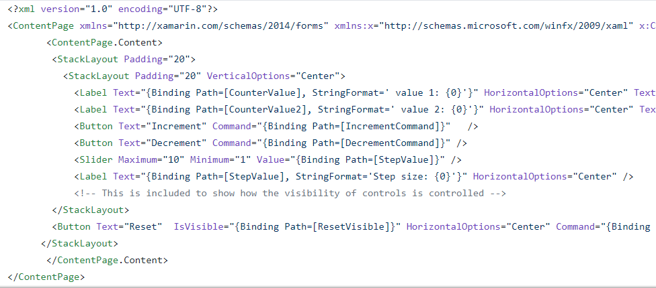
The VIEW DSL
Xaml looks like this:

Slide 51
The VIEW DSL
View looks like this:
let view (model: Model) dispatch =
View.ContentPage(content=
View.StackLayout(padding=30.0,verticalOptions = LayoutOptions.Center, children=[
View.Label(text= string model.Count, horizontalOptions=LayoutOptions.Center)
View.Button(text="Increment", command= (fun () -> dispatch Increment))
View.Button(text="Decrement", command= (fun () -> dispatch Decrement))
View.Slider(minimum=0.0, maximum=10.0, value=model.Step,
valueChanged= (fun args -> dispatch (SetStep (int args.NewValue))))
View.Label(text=sprintf "Step size: %d" model.Step, horizontalOptions=LayoutOptions.Center)
View.Button(text="Reset", horizontalOptions=LayoutOptions.Center,
command=(fun () -> dispatch Reset), canExecute = model.Changed)
]))

Slide 52
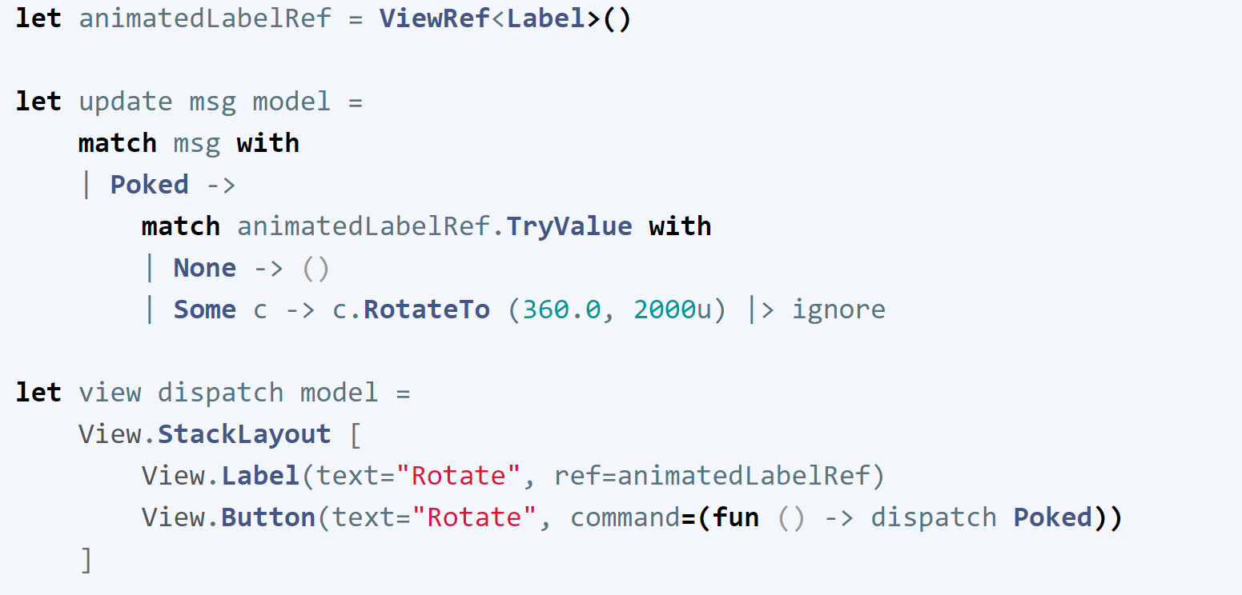
Animations
Yes you can
Uses “refs” like React

Slide 53
Multi-page apps
Yes you can
Still a single view function
CarouselPage, TabbedPage, NavigationPage with child pages
Each page has a model, message type and update function
You compose the pieces using F# code

Slide 54
Pragmatics
State persistence
Time-travel debugging
App size
Platform-specifics
Deploying
Extensibility

Slide 55
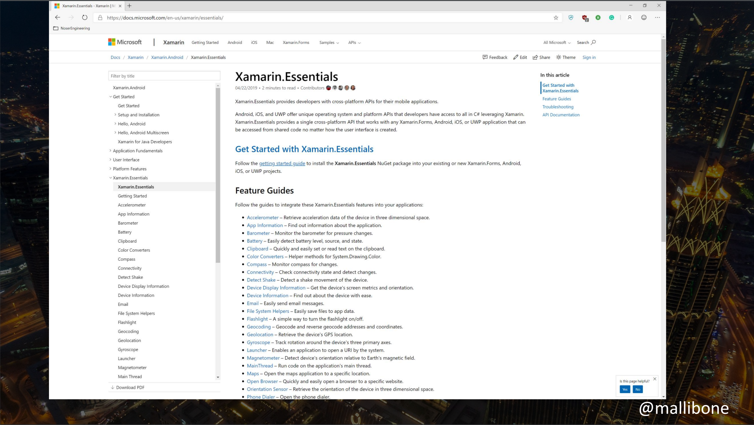

Slide 56
Making it efficient (SORT OF)
let view model dispatch =
…
View.Slider(minimum=0.0, maximum=10.0,
value=double model.Count,
valueChanged=(fun args -> dispatch (SliderValueChanged args.NewValue)))
…
This is a tree of immutable data describing the view
We want to avoid reallocating this data and re-traversing on each model update

Slide 57
Making it efficient (SORT OF)
let view model dispatch =
…
dependsOn (…) (fun model (count, step) ->
…
)
…

Slide 58
Making it efficient (SORT OF)
let view model dispatch =
…
dependsOn (model.Count, model.Step) (fun model (count, step) ->
View.Slider(minimum=0.0, maximum=10.0,
value=double count,
valueChanged=(fun args -> dispatch (SliderValueChanged args.NewValue))))
…
This recycles subtrees that are unchanged. Unchanged subtrees are not diff’d

Slide 59
NEXT STEPS
This is good, and enough for many information apps
We can do better, and it will be the focus of future work
Please come and help us apply Self-Adjusting Computations (incremental immutable data structures) to Fabulous
This is an invention of the PL community, and already applied in OCaml

Slide 60
Δ

Slide 61
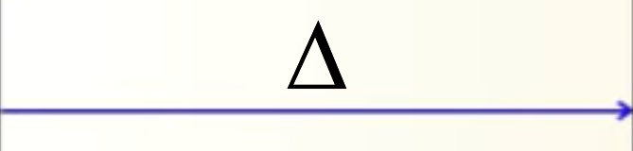
Δ

Slide 62
Possible window dressing
type Model =
{ … }
type Msg =
| …
| …
let init() =
{ … }
let update msg model = …
let view model dispatch = …
let app = mkApp (init, update, view)

Slide 63
Possible window dressing
[<ReflectedDefinition>]
type Model =
{ … }
type Msg =
| …
| …
let init() =
{ … }
let update msg model = …
let view model dispatch = …
let app = mkIncrementalApp (init, update, view)
Incrementalize the app,
(using F# quotations)

Slide 64
SUMMARY
MVU makes FP relevant to web, native, mobile and desktop UI
Fabulous brings this to cross-platform app programming
fsprojects.github.io/Fabulous
Research opportunities to apply recent advances in incremental immutable data structures (SAC) to enable high performance
Are their also opportunities for typing, correctness, verification, testing of these apps using PL techniques?

Slide 65
Questions?

Slide 66
Resources
fsprojects.github.io/Fabulous
View snippets
Docs
Links to Samples
Templates
How to use LiveUpdate (for small apps)
The AllControls sample
Awesome-Fabulous
Xamarin.Essentials
Xamarin docs (e.g.Forms, Android, iOS setup and deploy)
github.com/mallibone/FabulousIntro

Slide 67
Backup Slides

Slide 68
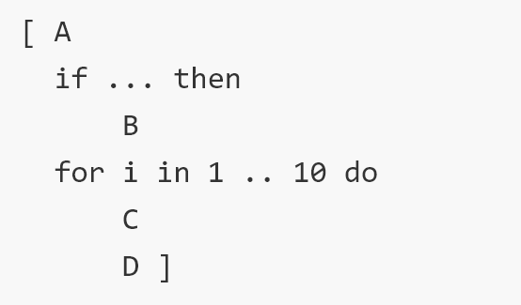
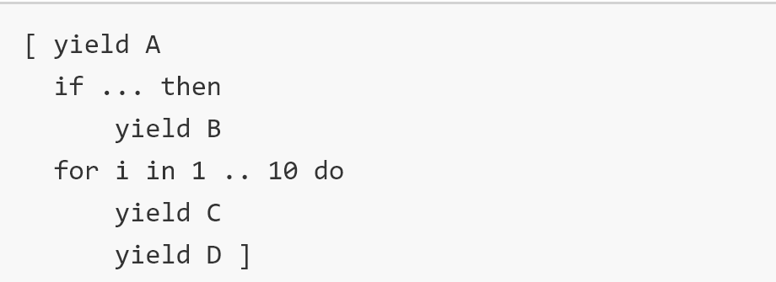
Why not C# 8.0?
Declaring message types is too clumsy
No records, pattern matching on them
No { r with Foo = … }
No unions
Declaring immutable dynamic views is clumsy
No expression-based computed collections, the iterator methods of C# are too clumsy for this - you need iterator expressions integrated with collection

Slide 69
CHEATING
Some cheats are available
created=(fun control -> …):
Lets you access underlying control on creation/recreation
View.Stateful:
adds local mutable state unrelated to the model. Breaks the functional approach but has uses for ephemeral state and rapid-mutation code.
View.WithInternalModel:
similar but for local immutable state
View.External:
wraps external Xamarin Forms objects, e.g. Page or View.

Slide 70
How to think: composition
“The pieces compose separately”
Compose the models, messages, update functions, view functions separately
“External” messages must be resolved during composition
“Encapsulation is not the emphasis”
The sub-page models not hidden when composed
OO encapsulation is strongly de-emphasized for model/view/update

Slide 71
THE SIMPLIFYING MAGIC
The magic is doing view re-evaluation

Slide 72
THE SIMPLIFYING MAGIC
The magic is doing view re-evaluation
(we use partial view re-evaluation and partial differential update to make it sufficiently efficient)

